Slide 1
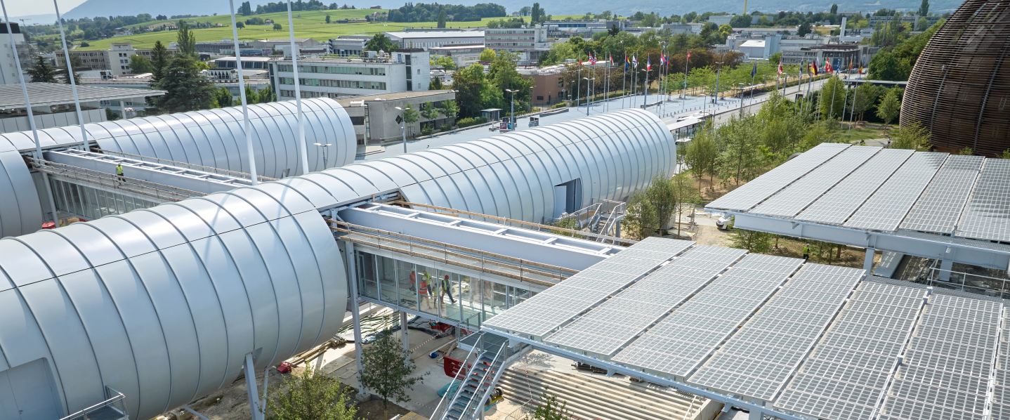
Group meeting (September 2024) Procurement Service

Slide 2
Procurement Strategy
Supplier Code of Conduct
Kraljic Matrix
Supplier Data Base
Electricity Contracts
AOB – Webinar Industry

Slide 3
Procurement Strategy

Slide 4
Audit Report on High Value Contracts (Dec.23):
Observations considered as major risks
Procurement response
Formalise a strategy for M/L term and develop KPIs to assess progress
Draft a set of key policies to support strategy
Strategy will be drafted in 2024.
KPIs (e.g. no more than x% of single source…)
Policies to be drafted in 2024:
Supplier’s management
Contract management
Communication
Personnel development
Sourcing?

Slide 5
SWOT analysis
STRENGTHS
WEAKNESSES
Kknowledge, expertise, diversity of team
Long track-record of delivery
Mature procurement processes, rules, framework, and documentation
Fully centralized function
Risk management could be reinforced
Limited resources
Limited sourcing and business intelligence
Administrative burden on vendors
THREATS
OPPORTUNITIES
Geopolitical context / global challenges: climate change; COVID-19 pandemic; energy crisis; war; inflation; recession, including supply-chain disruptions
FCC Procurement
Increased visibility to procurement added value with context (e.g., environmentally responsibility)
Geographical enlargement gives access to bigger markets
AI & new tools with help improve processes and market intelligence

Slide 6
Process followed for establishment of a Procurement Strategy
Internal consultation
Management approval
4 workshops within the Procurement Service
Publication
Presentation to ED
Presentation to ILO Forum
6

Slide 7
Procurement values: PROCURE
your colleagues,
your client,
your contractor
Be a trusted procurement partner
Seek solutions
Work with integrity, always in the interest of the Organization
PROfessionalism
Creativity
REspect
Support each other
Work in the interest of the Group
Help young professionals to grow
Share your experience
Unity
Think outside the box
Be creative
Test new ideas
Consider alternative perspectives

Slide 8
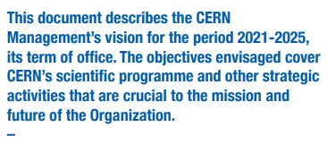
CERN’s three top-level objectives for 2021-2025:
To increase the return to Member States and Associate Member States
To strengthen CERN’s impact on society
To deliver world-class scientific
results and knowledge
Link

Slide 9
Procurement VISION:
to be a first class, innovative and trusted procurement partner
delivering best value for the Organisation and its stakeholders
Procurement’s Strategic objectives (2025-2030):
Procurement strategy
Policies
(supplier’s management - sourcing, contract management, communication, CERP, talent development)
Procedures
Deliver a best-in-class procurement service
Promote fair competition and better balance industrial return to MS and AMS
Support the Organization in its sustainability initiatives

Slide 10
How to deliver this strategy: To achieve the above objectives, the strategy will focus on the following five pillars:
Our people
Innovation and excellence
Supplier and contract management
Responsible procurement
Communication and outreach

Slide 11
Why this is important
PO specialized by categories
Diverse, knowledgeable and experience team necessary to better defend CERN interest
Team optimizes the overall cost for CERN by negotiating contracts that ensure CERN’s resources are used optimally…
Organization by sections specialized in categories or disciplines, enable the team to become experts in these markets
Team ensures that all procurement activities comply with CERN’s rules, regulations, ethical standards and protect CERN from contractual and reputational risks
OUR PEOPLE

Slide 12
What we will do and continue to strengthen
PO specialized by categories
OUR PEOPLE
Invest in regular training programs to keep the procurement team updated on the latest industry trends, technologies and best practices.
Coach and mentor our junior staff to help them navigate CERN ways of working.
Monitor workload and anticipate resource requirements.
Regular knowledge sharing opportunities, both internal and external.
Develop and launch a periodic employee engagement survey with HR support.
Establish a talent management policy and a succession plan.

Slide 13
KPI
OUR PEOPLE
All junior team members will be offered a partially funded training programme

Slide 14
Why this is important
To increase efficiency and ensure best use of our resources.
Adaptability to the future
Continuously improve our service where opportunities to be more efficient or impacting are identified.
Innovation and excellence

Slide 15
What we will do and continue to strengthen
Innovation and excellence
Drive digitalization through a new e-procurement system and supplier portal.
Adopt advanced procurement tools that harness the power of AI.
Carry out regular reviews of our processes and procedures against industry best practices.
Develop policies, including a sourcing, sustainable procurement, contract management and supplier management, communication, talent management, etc.
Continue to publish the annual procurement report.
Maintain an updated Internal Control System (ICS).
Publish customer satisfaction surveys to monitor our clients’ satisfaction.

Slide 16
KPI
Innovation and excellence
Customer satisfaction: at least 80% of satisfied/very satisfied clients
Annual objective in savings (including claims and costs avoidance): at least double than the cost of our Group
New policies:
Sourcing
Sustainable procurement
Contract management
Supplier management
Talent management
Communication
95% of ordrer to be approved within 5 working days

Slide 17
Why this is important
To mitigate risks for CERN
Better managed supply chains lead to better outcomes for CERN
To increase supplier performance and innovation
Supplier & contract management

Slide 18
What we will do and continue to strengthen
Supplier & contract management
Identify and classify strategic suppliers and contracts.
Keep developing and maintaining tailored management plans for strategic suppliers and contracts.
Monitor performance of contract identified as strategic and critical on an annual basis.
Carry-out a lessons learnt exercise for contracts identified as strategic and critical.
Monitor performance of suppliers identified as strategic and critical.
Develop and implement a risk-based approach policy for contract management.

Slide 19
KPI
All contracts identified as strategic and critical will have a risk assessment and contract management plan
Supplier & contract management

Slide 20
Why this is important
To align with CERN objective to strengthen its impact on society
To respond to our stakeholders’ expectations
Responsible procurement

Slide 21
What we will do and continue to strengthen
Responsible procurement
Implement an ESG assessment process for key suppliers.
Incorporate ESG criteria in the procurement procedures.
Assess and report on CERN scope 3 emissions.
Work with top suppliers to develop initiatives to reduce environmental impact of the products and services.
Launch Supplier Code of Conduct.

Slide 22
KPI
Responsible procurement
At least 50 suppliers will be assessed on sustainability performance each year
25 out of the top-emitting suppliers will report on scope 3 emissions by end of 2025
Training material developed and minimum two workshops per year with internal stakeholders on sustainable procurement

Slide 23
Why this is important
Transparency is key principle to bring confidence on our work
Externally: increases rate of participation in our tendering procedures, increases competitivity
Internally: regular communication builds strong relationships and increase understanding of our processes
Communication and outreach

Slide 24
What we will do and continue to strengthen
Communication and outreach
Provide regular updates and detailed reports on procurement activities.
Outreach programs to engage with suppliers, industry partners via webinars and industry events.
Utilize social media and LinkedIn to increase CERN procurement visibility and promote forthcoming needs and opportunities.
Continue with procurement trainings for technical teams.
Conduct regular impact surveys and report on CERN’s impact via procurement.
Organize a procurement conference event at CERN for relevant procurement professionals from similar organizations.

Slide 25
KPI
Communication and outreach
Obtain 3000 followers on LinkedIn by end of 2025
Minimum 2 industry webinar events held/year
Decrease by 20% the number of no responses following a tendering procedure by end of 2028

Slide 26
CERN Supplier Code of Conduct

Slide 27
Kraljic Matrix

Slide 28
High Value Contracts – Background
Audit report on High Value Contracts – slide presented in December 2023 Group meeting
Observations considered as major risks
Procurement response
The 30 major contracts start-up meeting memo will include a question concerning possible risk of inflation
The template of risk matrix will also be updated
The Procurement Officer will provide an annual executive summary for the 30 major contracts
Presentation made in March 2022 of how to deal with cost inflation and price revision will be repeated
FAQ will be updated accordingly
Establish a list of high-value contracts subject to inflation risk
Establish clear guidelines on how to proceed
Update templates

Slide 29
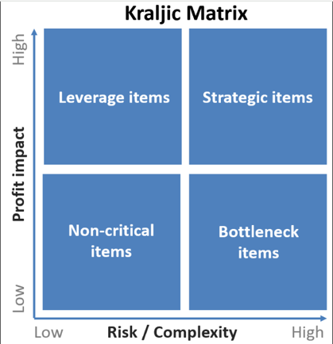
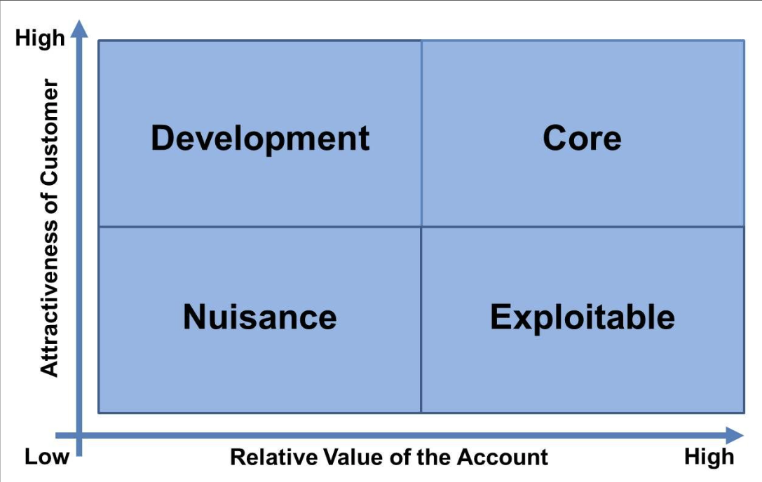
High Value Contracts – Implementation
How to identify the 30 major contracts?
By amount spent
By supply risk or complexity
Importance of CERN to the Supplier
Process:
Extract top 100 contracts by total contract amount
Kraljic Matrix: for each contract, score from 1 to 10 the:
The financial (or profit) impact of the contract: is the contract amount relatively high or low for CERN?
The supply risk/complexity: how critical is this supply? in case of failure to deliver, how big is the impact for CERN? What is the likelihood of supply disruption?
Steele and Court Model: for each contract, score from 1 to 10 the:
Attractiveness of customer: is CERN an attractive customer for the supplier (ordering amount, delivery schedules, types of orders...)?
Relative value of the account: is CERN a small or large customer for the supplier?
Add to the list any strategic contract which is missing (not signed yet, or not in the top 100 in terms of contract amount).
KRALJIC MATRIX
STEELE AND COURT SUPPLIER PREFERENCING MODEL
https://cernbox.cern.ch/s/UHuD3N0NBue9TSN

Slide 30
High Value Contracts – Implementation
How can this information be used?
Creation of a score from 0 to 100 to represent the importance of the contract for CERN and for the Supplier.
Importance for CERN: “Profit impact” score x “Supply risk” score
Importance for Supplier: “Attractiveness of customer” score x “Relative value of the account” score
Reasoning: there may be an added layer of risk if the contract is strategic for CERN but is considered a nuisance for the Supplier.

Slide 31
High Value Contracts – Results
KRALJIC MATRIX
125 contracts were scored
Kraljic:
6 Strategic for CERN, out of which 1 is a Nuisance for Supplier (U014 - Supply of electrical energy)
8 Leverage out of which 3 are a Nuisance for Supplier
23 Bottleneck out of which 6 are a Nuisance for Supplier.
Steele and Court: 21 Core and 48 Development contracts for Suppliers
STEELE AND COURT SUPPLIER PREFERENCING MODEL
Notes:
3 leverage / nuisance: S233 HVAC facilities management, F776/RCS Cryostat structural elements, T150/SCE Contractor - Renovation of B60
and 87 Non-critical
Steele and court: our perception, will need to be verified with the Impact study which will allow us to have more information. We are important, this does not mean that there is no risk.
Conclusion: only 6 strategic contracts to closely watch, number is manageable.
https://cernbox.cern.ch/s/UHuD3N0NBue9TSN

Slide 32
Kraljic Matrix – Top 50
Strategic items
Leverage items
Bottleneck items
Non-critical items
https://cernbox.cern.ch/s/UHuD3N0NBue9TSN
Notes:
Top 50 contracts selected for simplification of the chart

Slide 33
Steele and Court Model – Top 50
Core
Development
Exploitable
Nuisance
https://cernbox.cern.ch/s/UHuD3N0NBue9TSN
Notes:
Top 50 contracts selected for simplification of the chart (mettre nom des contrats)
Will require specific follow-up to be put in place.

Slide 34
>50 importance for CERN
Importance for CERN and Supplier – Top 50
Top 30 contracts
https://cernbox.cern.ch/s/UHuD3N0NBue9TSN
Notes:
Top 50 contracts selected for simplification of the chart
Top 30 : up to B1716/EP – Outer track hybrid cicruits, Valtronics Technologies (x=49, y=16)
https://cernbox.cern.ch/s/UHuD3N0NBue9TSN

Slide 35
High Value Contracts – Next steps?
A contract management policy will be put in place (2025), in line with the procurement strategy being developped
A similar analysis will be performed to identify critical suppliers
A supplier management policy will be put in place
THANK YOU
to everyone who took part in this exercise
https://cernbox.cern.ch/s/UHuD3N0NBue9TSN

