Slide 1
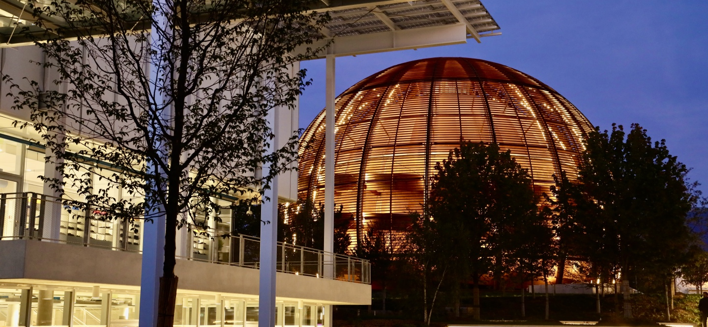
IPT-PI Group meeting
14 November 2024

Slide 2

AGENDA
2024 impact survey
¼ d’heure qualité: new guidelines - bank guarantees
¼ d’heure qualité: rules applicable to external funds
Refresher(s): letter to ILOs + LT
BCO corner
AOB

Slide 3
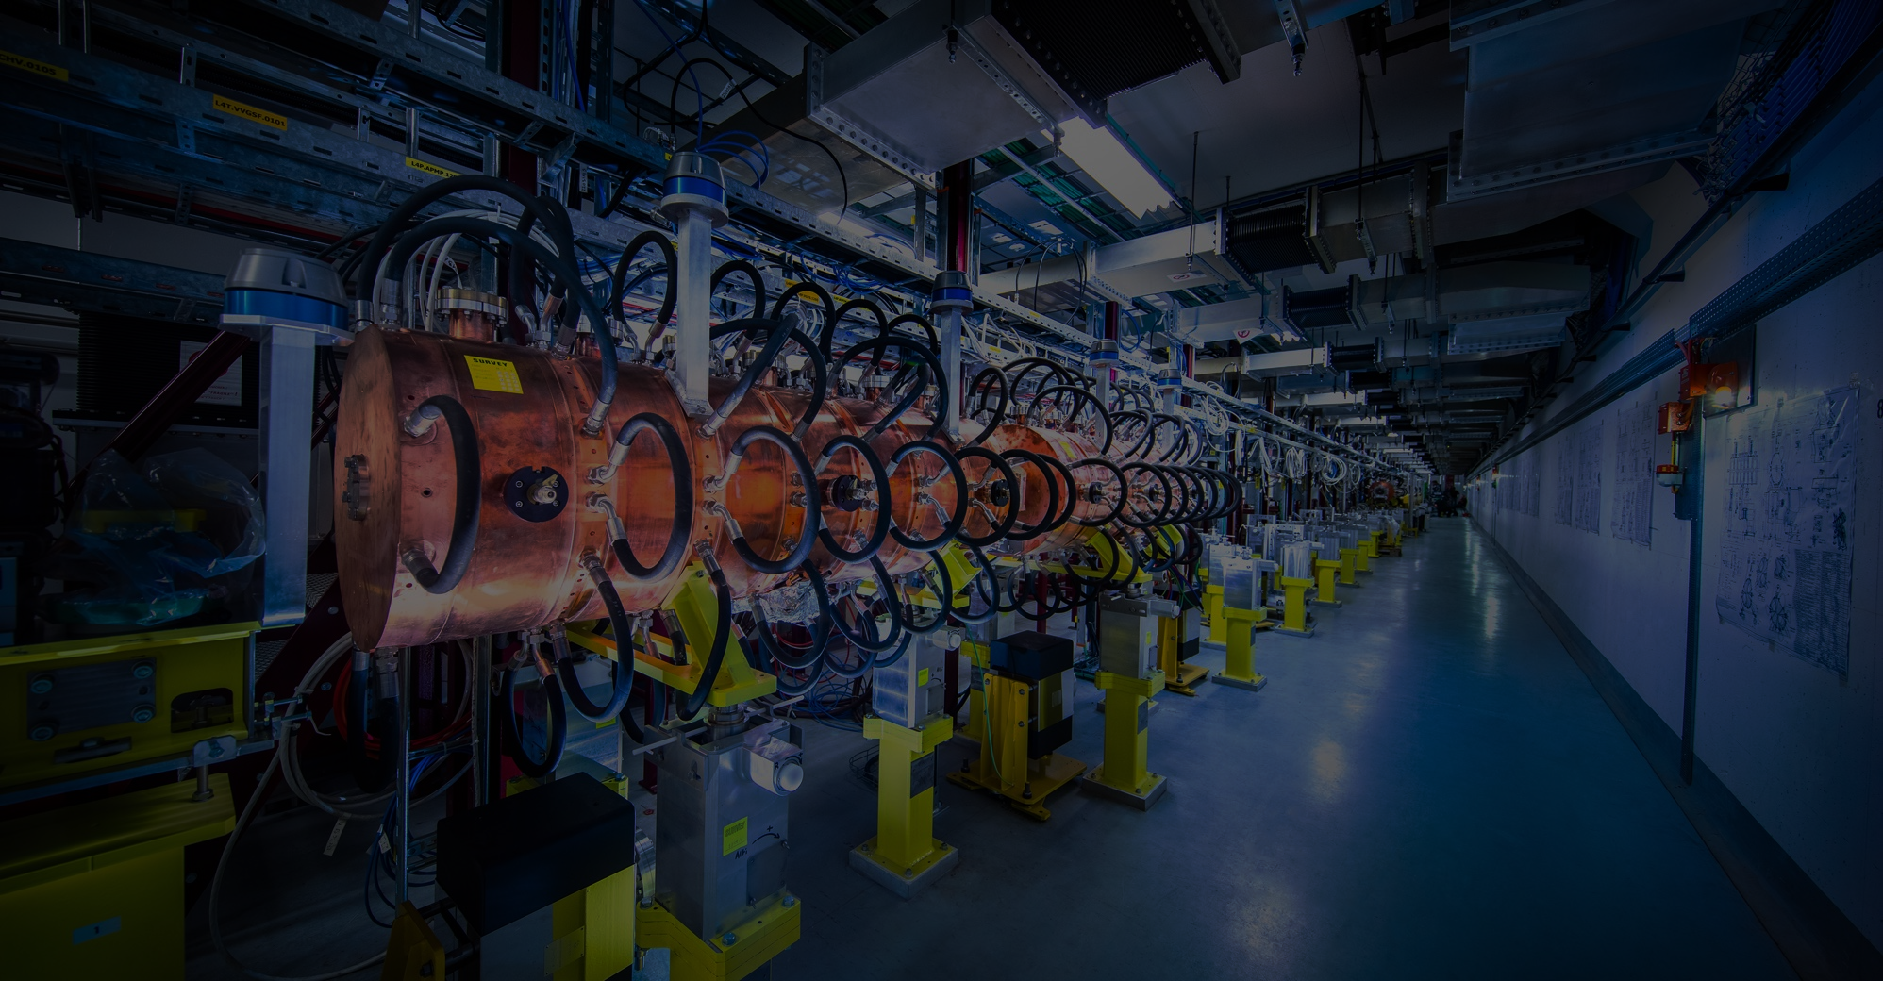

Before we start

Slide 4

Welcome Fella !

Slide 5
2024 IMPACT SURVEY
Lionello D’ambrosio
November 2024

Slide 6
Agenda
Scope & Data Collected
Country of head office
Family Code & Company Size
CERN Importance / Attractiveness
Working with CERN enabled your company to improve the products or services that it sells
Working with CERN enabled your company to develop new products
Working with CERN enabled your company to improve technical knowledge in its field
Working with CERN enabled your company to find or open new markets to address new ones
Impact on sales (by industry)
Hired new personnel (by industry)
Comments on positive aspects
Comments on how to improve

Slide 7
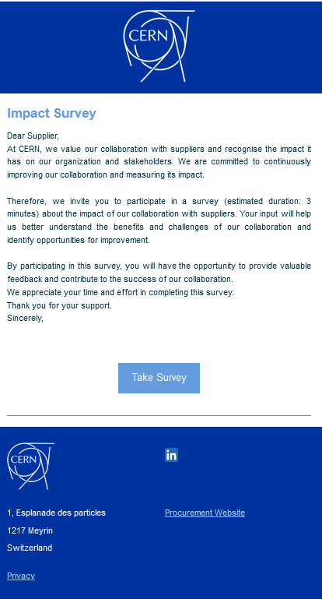
Scope and data collected
Objective:
Evaluate Supplier Satisfaction
Understand Strengths/Weaknesses
Assess Impact
Questionnaire:
15 questions
Sent to:
1569 suppliers with +50K CHF orders in 2022
How:
Weekly automated emailing through SpotlerMail+
Response Rate
489 responses out of 1569 = 31%

Slide 8

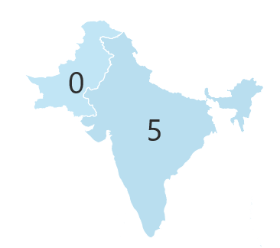
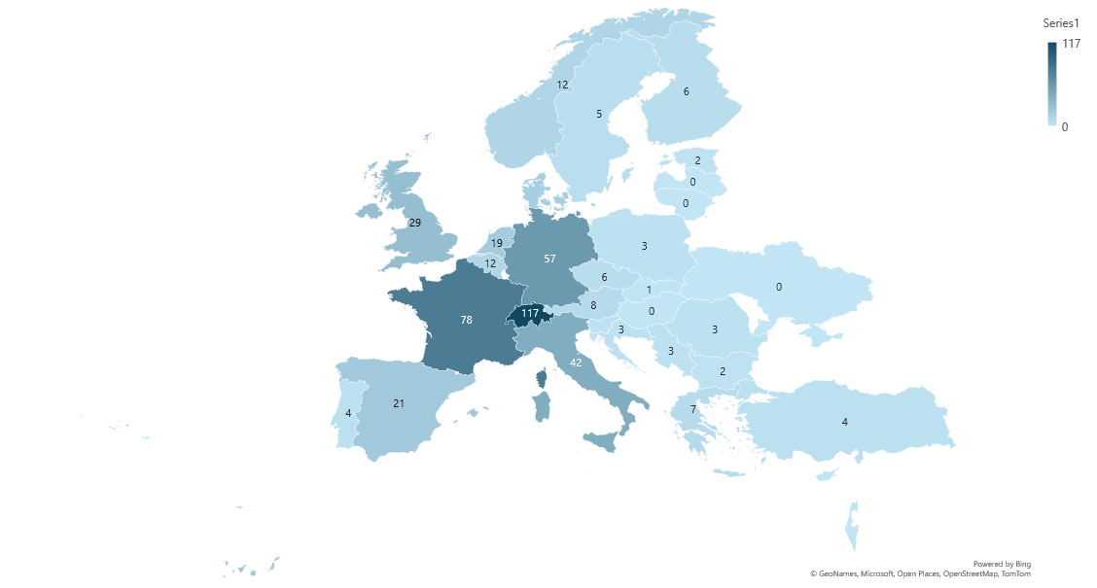
Country of head office
5
1

Slide 9
Family Code & Company Size

Slide 10

CERN Importance / Attractiveness
4.53/5
Average Rating
67% of suppliers say CERN is highly attractive as a client

Slide 11
Working with CERN enabled your company to improve the products or services that it sells

Slide 12
Working with CERN enabled your company to develop new products

Slide 13
Working with CERN enabled your company to
improve technical knowledge in its field

Slide 14
Working with CERN enabled your company to find or open new markets to address new ones

Slide 15
Impact on sales (by industry)

Slide 16
Hired new personnel (by industry)

Slide 17
Comments on how to improve

Slide 18
Comments on Positive Aspects

Slide 19
¼ d’heure qualité
New guidelines on bank guarantees
Cristina Lara
November 2024

Slide 20
Overview on 31 December 2023
 | number | % in number | Total amount in CHF | % in CHF
> 1M | 14 | 3.52% | 41,316,895.13 | 43.72%
500K - 1M | 20 | 5.03% | 14,031,429.83 | 14.85%
200K - 500K | 63 | 15.83% | 19,438,432.36 | 20.57%
100K - 200K | 66 | 16.58% | 9,165,513.45 | 9.7%
50K - 100K | 87 | 21.86% | 6,381,525.62 | 6.75%
20K - 50K | 106 | 26.63% | 3,608,593.95 | 3.82%
10K - 20K | 32 | 8.04% | 477,161.01 | 0.5%
<10K | 10 | 2.51% | 85,918.51 | 0.09%
TOTAL | 398 | 100% | 94,505,469.86 | 100%
Estimated annual cost for CERN: ~1.3MCHF
Number of BG withdrawn in the past 3 years: 0
Cristina Lara Arnaud

Slide 21
What types of risks can be covered by a bank guarantee?
Risk mitigation:
A BG reduces the financial risks associated with contractor non-performance or default by contractor during contract execution or warranty period, including if contractor:
goes bankrupt,
fails to perform,
faces financial problems…
CERN may use the BG to:
finalise the work,
replace the equipment or
pay a 3rd party to take over the contract.
Reduces legal hassles:
In the event of non-compliance or default, going through arbitration may take time, the BG can be used as “épée de Damoclès”
Financial risk:
A BG provides assurance that the contractor will fulfill their financial and contractual obligations, in particular if CERN has advance any payment or provided material.
A contractor non being able to provide a BG, needs to be investigated as this could be a red flag.

Slide 22
Benchmark with Eiroforum organisations
Organisation | Advance payment | Performance guarantee
ESA | Not as a standard Mainly under EU programmes as it is a requirement Alternative: garantie maison mère (mother company guarantee) | Mainly when the performance could be assessed years later (eg. Only verifiable when the satellites has reached its destination)
ESS | Few cases for large contracts | Few cases for large contracts
SKAO | >50kEUR Alternative: ask for property titles | On a case by case basis Particularly problematic for Australian firms
ESRF | >50kEUR | Few contract Alternative: retain a certain amount
EMBL | >10kEUR | n.a.

Slide 23
When a bank guarantee may be requested?
Advance payment >50kCHF
Validity: until acceptance of equivalent supplies/services
Amount: same as advance payment
Raw material or components provided by CERN >50kCHF
Validity: until end of warranty period
Amount: estimation of the replacement of materials
For performance: see next slide
NEW
No bank guarantee necessary in case of advance payment <50kCHF
NEW
No bank guarantee necessary <50kCHF
NEW
No bank guarantee for PERFORMANCE <500kCHF
Cristina Lara Arnaud

Slide 24
Bank guarantee for performance guidelines, in practice…
For Civil engineering contracts:
Validity:
2 years for a contract<1MCHF
10 years for a contract>1MCHF
Amount:
10% of contract value. However for contracts >1MCHF, the value can be 2% following the first 2 years of the warranty period
For supplies:
Validity: Until end of warranty period
Amount: maximum 10% of order/contract value
For service contracts:
Validity: 3 or 6 months after the end of contract
Amount: 10% of the first contract year
EXCEPTIONS
NO bank guarantee usually required for:
Professional services paid upon acceptance
Standard off-the-shelf
Collaboration agreements
Utilities
Think if 10% of the contract is appropriate or not. Discuss with SL in particular for B contracts

Slide 25
Financial institutions accepted by CERN
CERN accepts:
Bank guarantees from bank BBB+
Bank guarantees from insurance companies BBB+
Counter-guarantees from a bank BBB+
(in case where the original bank is rated lower than BBB+)
Stand-by letters of Credit (SBLC) from a financial institution BBB+
The template is the same as the current one.
All charges will have to be paid by the contractor.
Any other format or deviation needs to be approved by FAP DL.

Slide 26
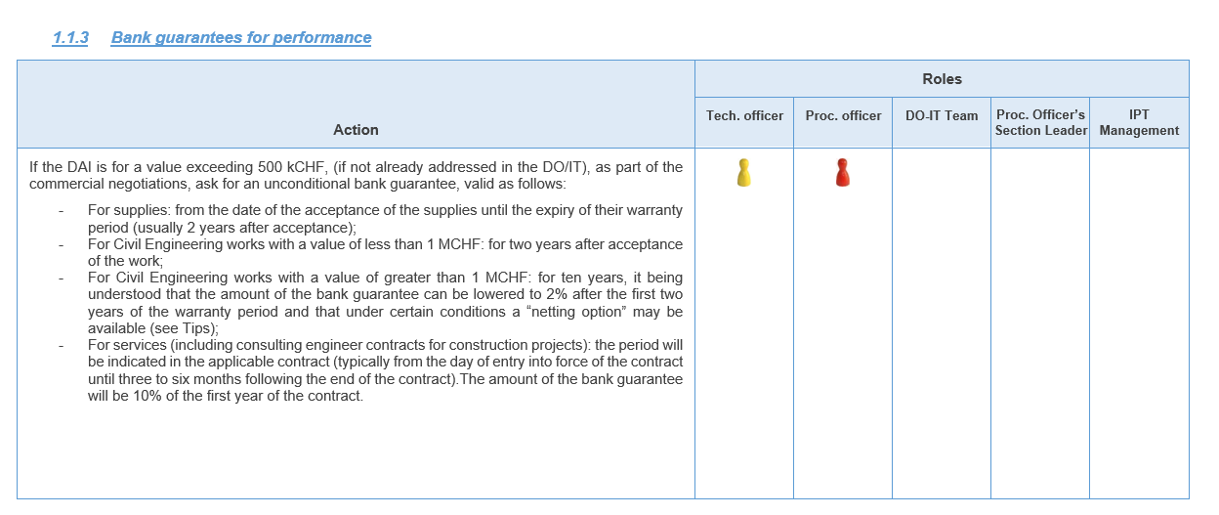
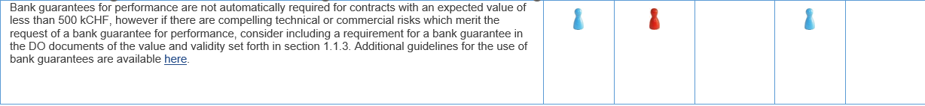
Additional information
  → The PPM were updated (advance payments, bank guarantees for performance, orders, DO/IT, contracts)

Slide 27
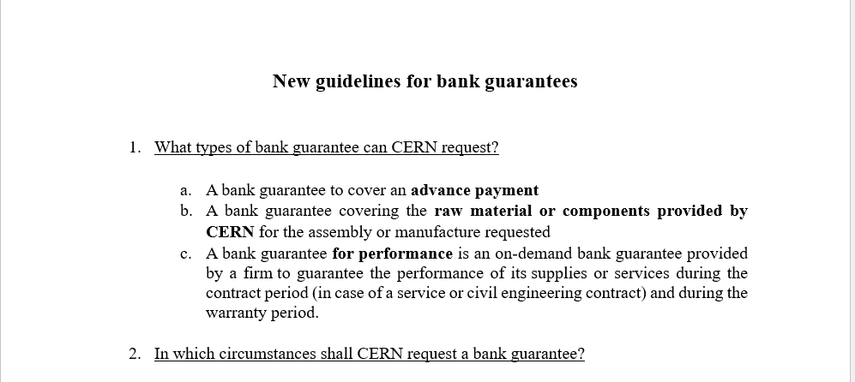
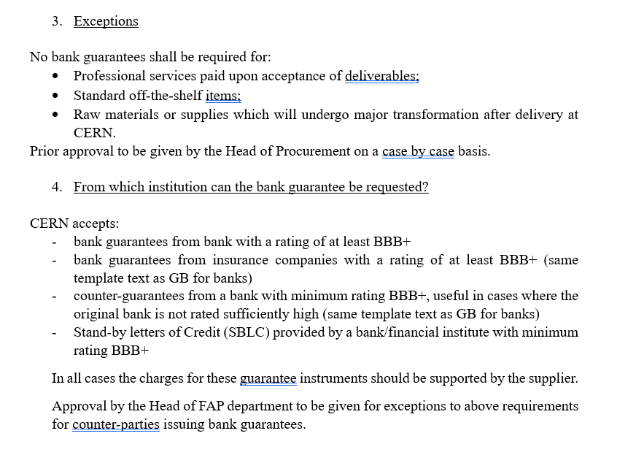
Additional information
  → The new guidelines were published (DFS) and are referred to in the PPM

Slide 28
¼ d’heure qualité
Rules applicable to External Funds
Cristina Lara
November 2024

Slide 29
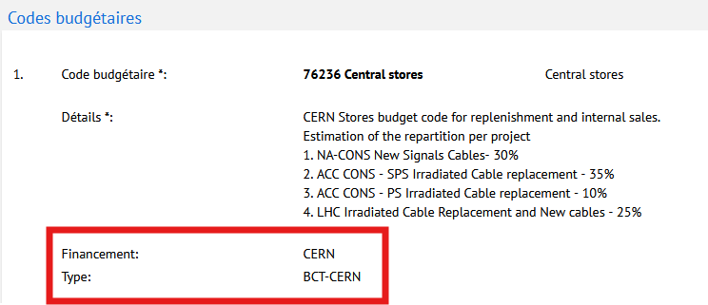
FUNDING and BUDGET CODE TYPE (BCT)
DAI :
DEPARTMENTAL REQUEST (DR) :
Based on the combination of the funding source and the budget code type, different procurement rules may apply,
  Section 1 General Rules
  Section 7 Procurement rules for Contracts funded wholly or partially by External Funds
    Case A do not involve Member State contributions and where the contracting parties intend to act independently of CERN
    Case B do not involve Member State contributions but where CERN is requested to be the contracting party
      Case B1 All cases
      Case B2 Additional provisions applicable to approved or recognised experiments only
    Case C Member State contributions contribute to the financing of the Requirements, excluding cases where Requirements are entirely funded by an approved or recognised experiment using a collaboration account
    Case D Requirements funded by an approved or recognised experiment using a collaboration account (and to which CERN makes a contribution)
https://cds.cern.ch/record/2162762/files/CERN_FinancialRules_en.pdf
14.11.2024
Rules applicable to external funds
29
29

Slide 30
BCT and Procurement Case
FUNDING SOURCE | Budget Code Type | Procurement Case (applicable § in Procurement rules) |  | FUNDING SOURCE | Budget Code Type | Procurement Case (applicable § in Procurement rules)
DONATION | BCT-CERN | CASE B (§22.1) |  | TEAM | BCT-CONST | Ask RC if CERN funding to determine if - CASE D (§24) (if there is CERN money) - CASE B (§22.2) (no CERN money)
EU | BCT-CERN | CASE B (§22.1) |  | TEAM | BCT-INST | CASE B (§22.2)
EXTREV | BCT-CERN | CASE B (§22.1) |  | TEAM | BCT-MOA | Ask RC if CERN funding to determine if - CASE D (§24) (if there is CERN money) - CASE B (§22.2) (no CERN money)
IN-KIND | BCT-CERN | CASE A (§21) |  | TEAM | BCT-MOB | Ask RC if CERN funding to determine if - CASE D (§24) (if there is CERN money) - CASE B (§22.2) (no CERN money)
ITER | BCT-CERN | CASE B (§22.1) |  | TEAM | BCT-S-CERN | CASE B (§22.1)
OPENLAB | BCT-CERN | CASE B (§22.1) |  | TEAM | BCT-S-FND | CASE B (§22.1) or CASE B (§22.2) in case for an approved or recognised experiment
TT | BCT-CERN | CASE B (§22.1) |  | TEAM | BCT-UP-1 | Ask RC if CERN funding to determine if - CASE D (§24) (if there is CERN money) - CASE B (§22.2) (no CERN money)
TEAM | BCT-COLLAB | Ask RC if CERN funding to determine if - CASE D (§24) (if there is CERN money) - CASE B (§22.2) (no CERN money) |  | TEAM | BCT-UP-2 | Ask RC if CERN funding to determine if - CASE D (§24) (if there is CERN money) - CASE B (§22.2) (no CERN money)
TEAM | BCT-VRT | CASE B (§22.2) |  | TEAM | BCT-UP-3 | Ask RC if CERN funding to determine if - CASE D (§24) (if there is CERN money) - CASE B (§22.2) (no CERN money)

Slide 31
Rules appliable to External Funds
 | CASE A (§21) in-kind contributions | CASE B (§22.1) e.g. donations | CASE B (§22.2) only applicable to approved and recognised experiments | CASE C (§23) mixed funding (CERN+extenal funds) | CASE D (§24) Common Fund procurements for approved and recognised experiments only
Order by CERN (DAI) | not applicable | yes | yes | yes | yes
Budget code | not applicable | CERN (starting with a digit) | TEAM (starting with ‘T’ or 23xxx) | CERN (starting with a digit) | TEAM (starting with ‘T’)
Budget Code Type / Funding source | not applicable | DONATION/ EU/ EXTREV/ ITER/ OPENLAB/ TT/ S-FND (if not for an experiment) | INST/ VRT/ S-FND (for an experiment)/ all mentioned as case D if no CERN money | CERN + TEAM/ DONATION/ EU/ OPENLAB/ TT | COLLAB/ CONST/ MOA/ MOB/ UP-1/ UP-2/ UP-3 Needs to check with the resource coordinator if there is CERN money (otherwise, all those codes will be treated as case B (§22.2)
Tender by CERN | not applicable | yes | Yes (incl. with proof of correctness and transfer of risks and liability) | yes | yes
Country of Origin only MS/AMS (§4) | not applicable | not applicable | can request that at least 50% of the value of the bid originates from the countries providing the funding for that contract | yes | from CERN MS and AMS and the countries from the collaboration providing the funding for that contract
Limited Tendering (§4.4) | not applicable | not applicable | not applicable | yes | not applicable
Alignment (§15.2) | not applicable | not applicable | not applicable | yes | not applicable
Splitting in case of alignment (§15.3) | not applicable | not applicable | not applicable | yes | not applicable
Finance Committee Approval (§19) | not applicable | yes | yes, except if transfer of risk and liability or MOU | yes (for CERN contribution) | yes (for CERN contribution)

Slide 32
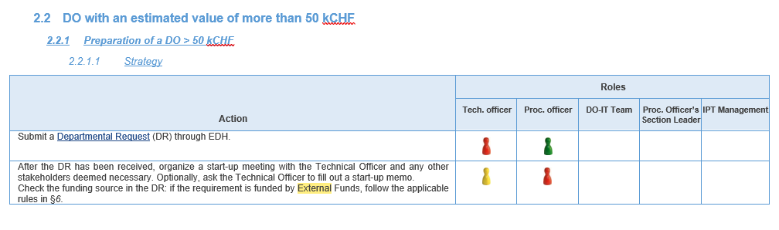
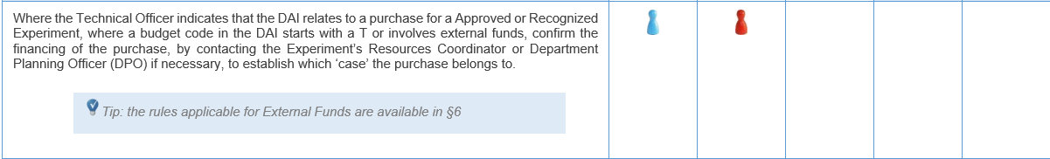
Additional information
  → The PPM were updated (DR, start-up meeting, PE/MS, DAI, annexes)

Slide 33
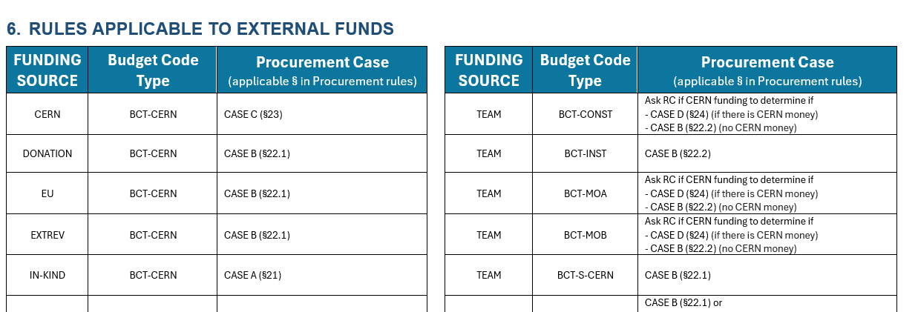
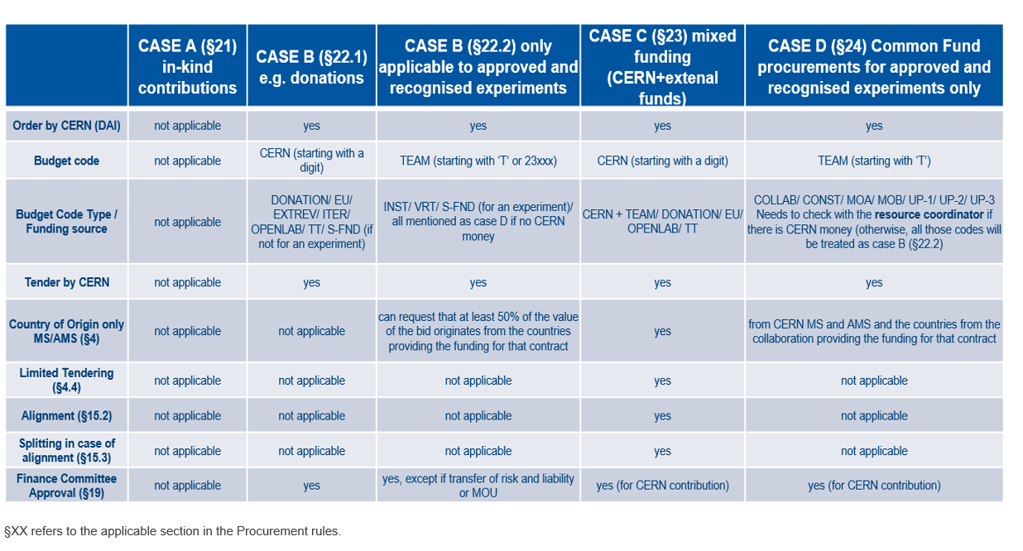
Additional information
  → The PPM were updated (DR, start-up meeting, PE/MS, DAI, annexes)

Slide 34

Refresher(s)

Slide 35
Letter to ILOs for contracts between 750kCHF and 1.5MCHF

Slide 36
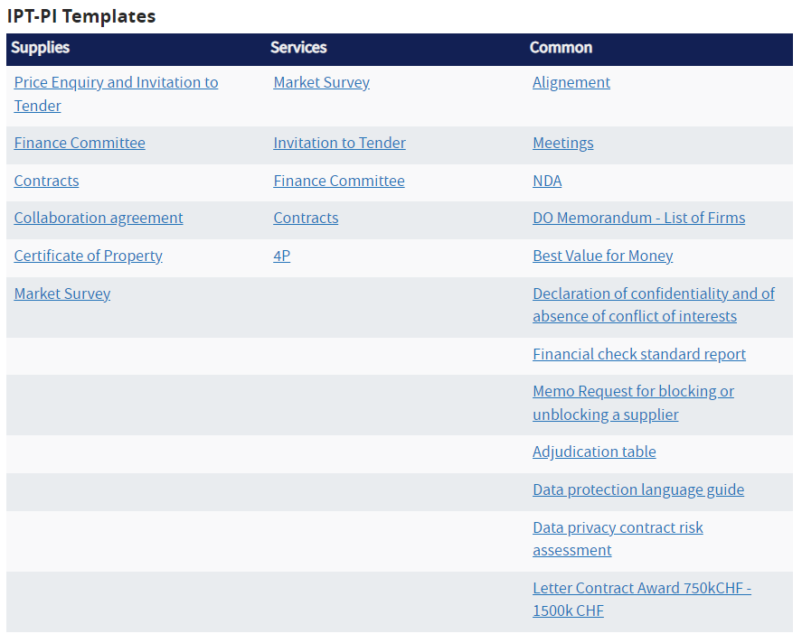
Group members: new templates
Procurement Templates (IPT)

Slide 37
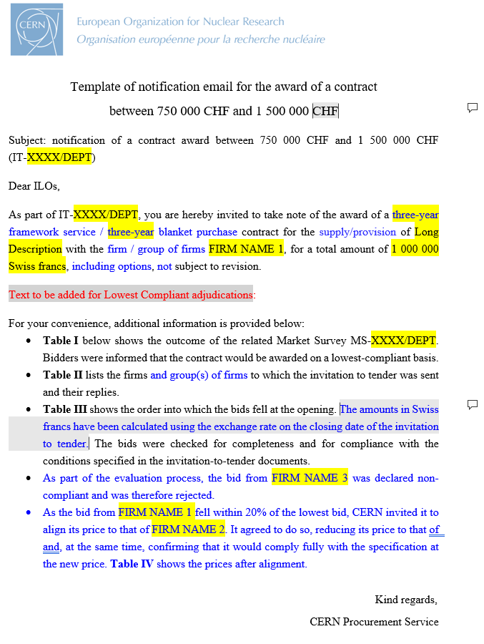
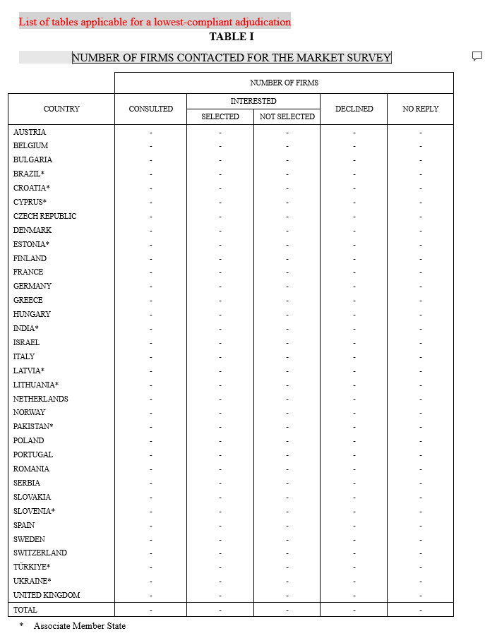
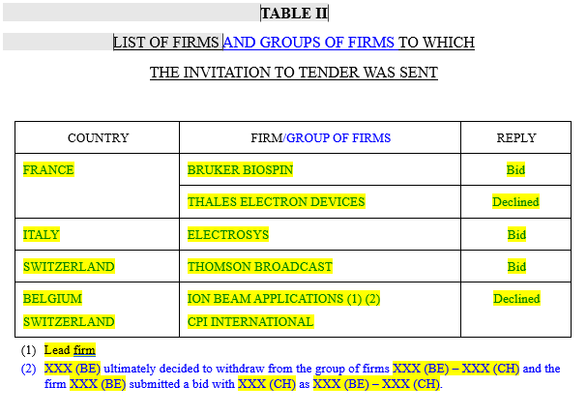
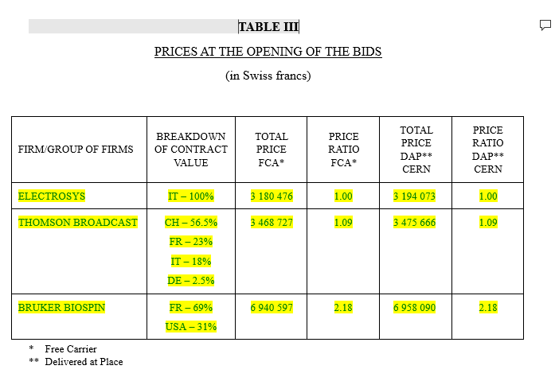
Notification of contract between 750kCHF and 1.5MCHF
Procurement Templates (IPT)
Following modification of proc. Rules, PI committed to inform ILOs
Template both for LC and BVFM adjudications
Approval by SL
2 weeks before signing a contract btw 750k-1.5MCHF

Slide 38
Limited Tendering

Slide 39
Limit competition to:
List to be reviewed on an annual basis (1st March)
Brazil
Ukraine
Israel
Romania
Sweden
Cyprus
Belgium
Denmark
Norway
Greece
United Kingdom
India
Serbia
From today:
CERN may, in cases where it is believed there is sufficient competition, contact only firms proposing Supply and Services originating in these Member States
Current text: “contact only firms from MS with a return coefficient below 0.4”
At least 60% shall be originated in at least one of the 12 MS to participate to a Limited Tendering.
If a new AMS arrives after 1st March, it will be added to the list
If an AMS reaches its ceiling, it will be removed and a new MS will be added.
On 1st January, if the ceiling has not been reached, the AMS will be added again
39

Slide 40
ALL ILOs will be informed
FAQ on Limited Tendering (LT)
How many LT procedures can be carried out every year?
Maximum 25% of all procedures (representing no more than 15% of the total value)
When will LT be announced?
For DO/ITs: when the DO/IT will be launched as IT-XXXX/DEPT/LT or DO-XXXXX/DEPT/LT
Is LT foreseen for Supply and Service contracts?
LT is not expected to be used for industrial services on the CERN site
When should a LT procedure take place?
For DOs: If at least 4 firms eligible are identified
For ITs: If at least 6 firms eligible are identified
to ensure enough competition
When MAY CERN conduct a Tendering Procedure open to all MS AND a LT one? Whenever the future contract can be split into at least 2 contracts.
Each procedure will request, as options, the quantities requested in the other procedure to cover the total needs. The intention is to place 2 contracts.
Is CERN obliged to place both contracts?
No, if one of the selected bidder for one of the procedures is significantly higher, only one contract could be placed for the total needs
What does significantly higher means?
Max. 20% for a contract <500kCHF
Max. 15% for a contract 500k to 1MCHF
Max. 10% for a contract >1MCHF
Are firms invited for LT procedures entitled to reply to the open one?
Of course
40

Slide 41
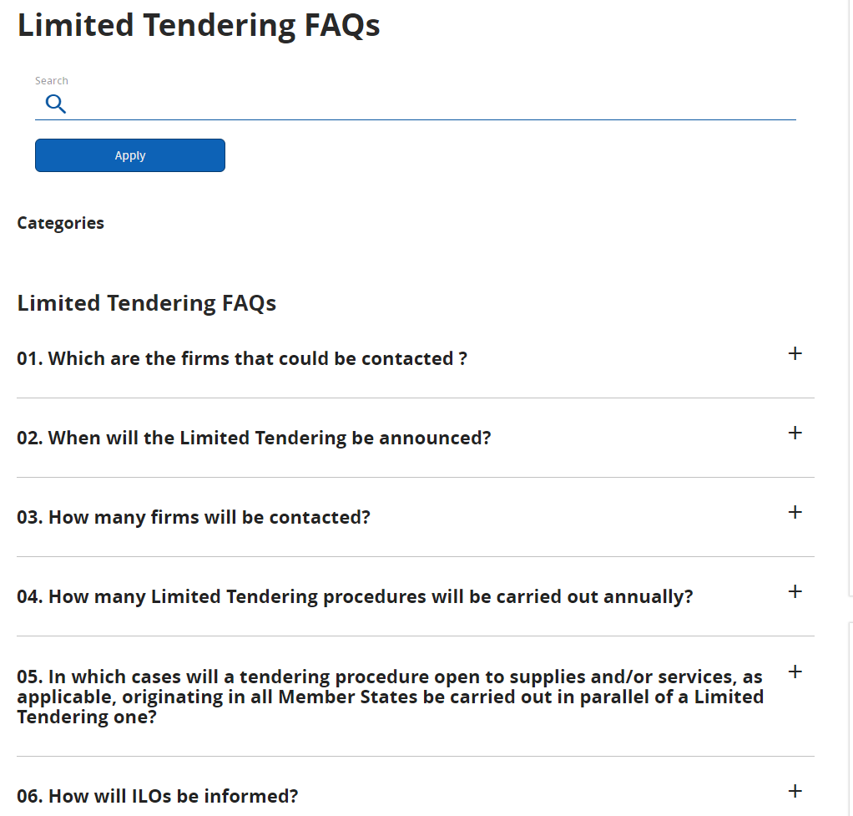
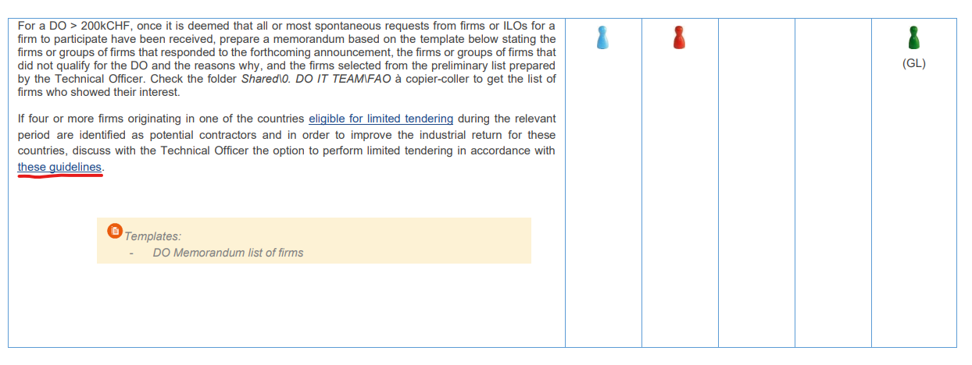
Limited tendering guidelines (FAQ):
Referred to in PPM
Link: https://procurement.web.cern.ch/faq-category/limited-tendering-faqs
41

Slide 42
BCO - update
Simon Guerri dall’Oro (IPT-PI-OS)
November 2024

Slide 43
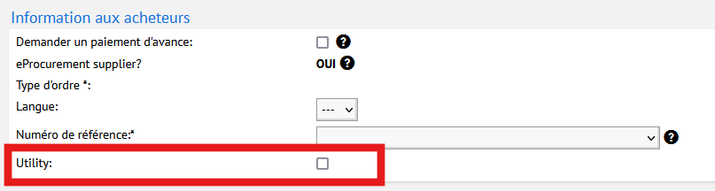
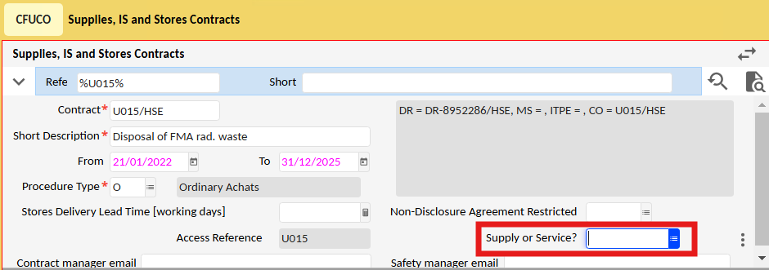
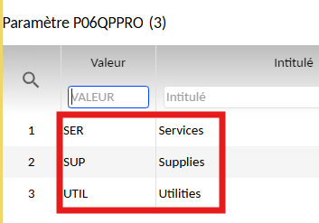
UTILITY
DEFINITION : a Supply or a Service that necessarily has a French or Swiss origin for technical, geographical or legal reasons.
A Utility may be tendered or not (this is not a relevant criteria)
DAI
New box in the DAI to tick. By default, “NO”
Automatically integrated in the DAI
CONTRACT
New field in the contract, per market,
ie, we could have 3 different market under a contract:
  Supply
  Service
  Utility
Set up during the “minute” (updated)
Automatically integrated in the corresponding DAI (DL order)
43

Slide 44
VARIATION ORDERS
New EDH document for civil engineering contract (IPT-PI-CE) in Prod.
The new variation order form has been developed by FAP-BC specifically for the tracking of variations on civil engineering works contracts with variation provisions.
This follows a previous audit finding showing that in certain cases, there can be significant periods of time which elapse between a variation to a works contract being agreed and then being accounted for by FAP.
This simple form is to be completed by any Procurement Officers handling works contracts of this type.
44

Slide 45
DAI & OSVC SIGNATURE WORKFLOW
Reviewed and in production.
Update of the signature rights (2 x PO50KCHF)
Replacement during absences
Revision of the OSVC roles
Addition of single source concept for OSVC (X contracts) and relevant signatures
Please come back to me if you see any mistake, errors, bypass signatures with EDH number and screenshots.
45

Slide 46
NEWS
ChatGPT (or other) pilot project early 2025 in admin sector with limited number of licences.
46

Slide 47
AOB

Slide 48

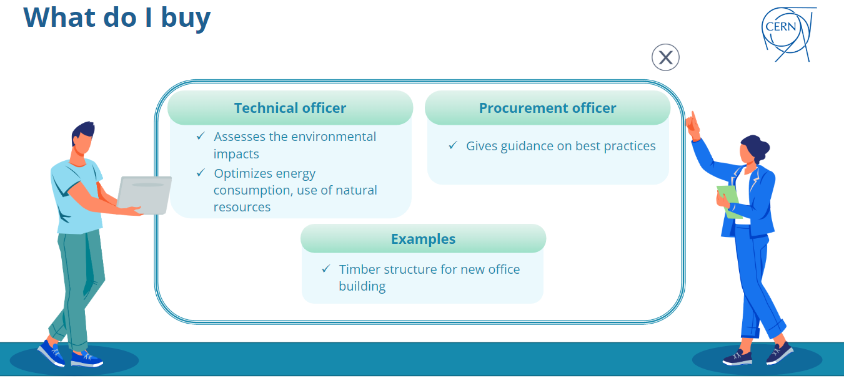
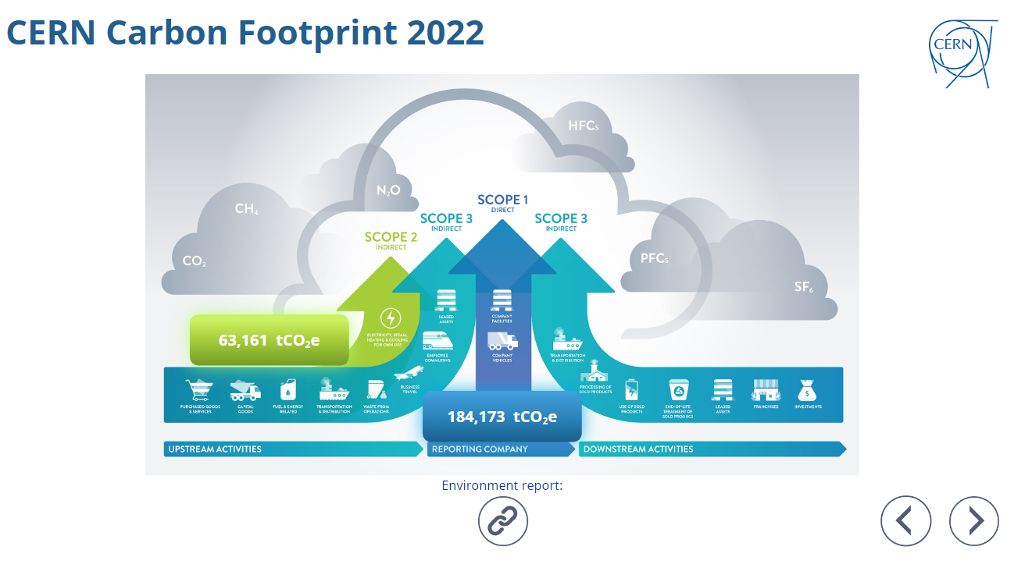
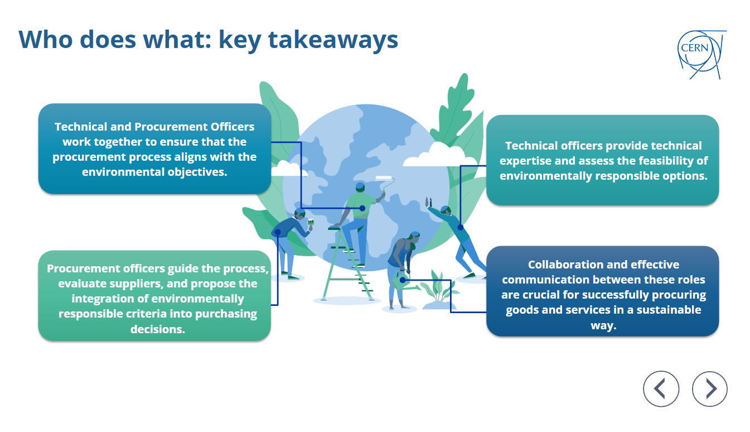

Sustainable Procurement: raising awareness training: Link
=> Please follow the course
=> Next: dedicated training for POs
Thank you Miriam / Enrico !

Slide 49


NEWS
?
?
Bravo Adam / Sandrine / Aneta !
49

Slide 50





Save the dates
2nd December (Open Space): Buffet canadien* + Secret Santa
*Potluck meal, all guests bring food to share.
5th December (evening): IPT party in Geneva
(table football event before)

