Slide 1
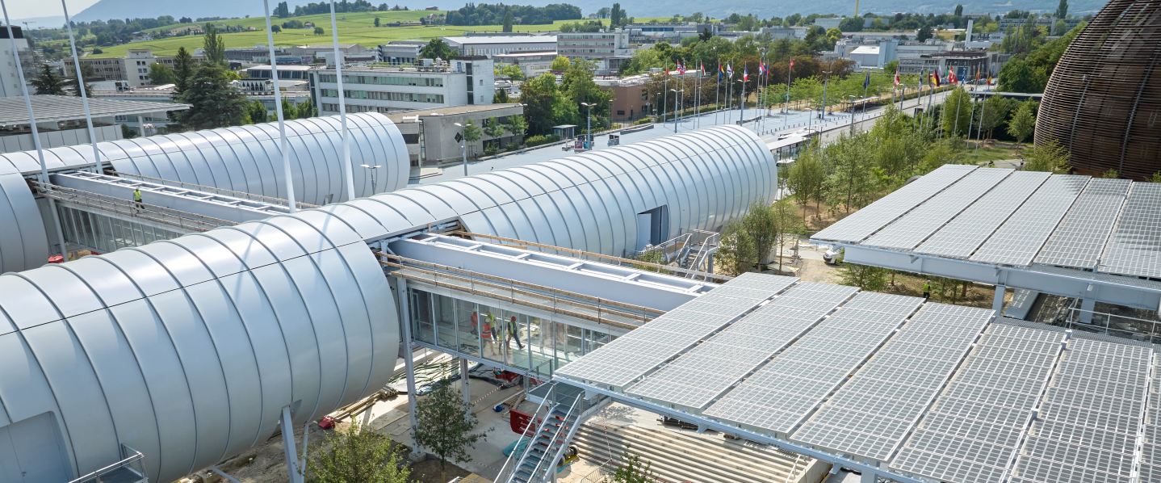
Procurement Service (update organization) June 2024

Slide 2
rationale
Persons leaving
Work recognition
New needs of the Organisation

Slide 3
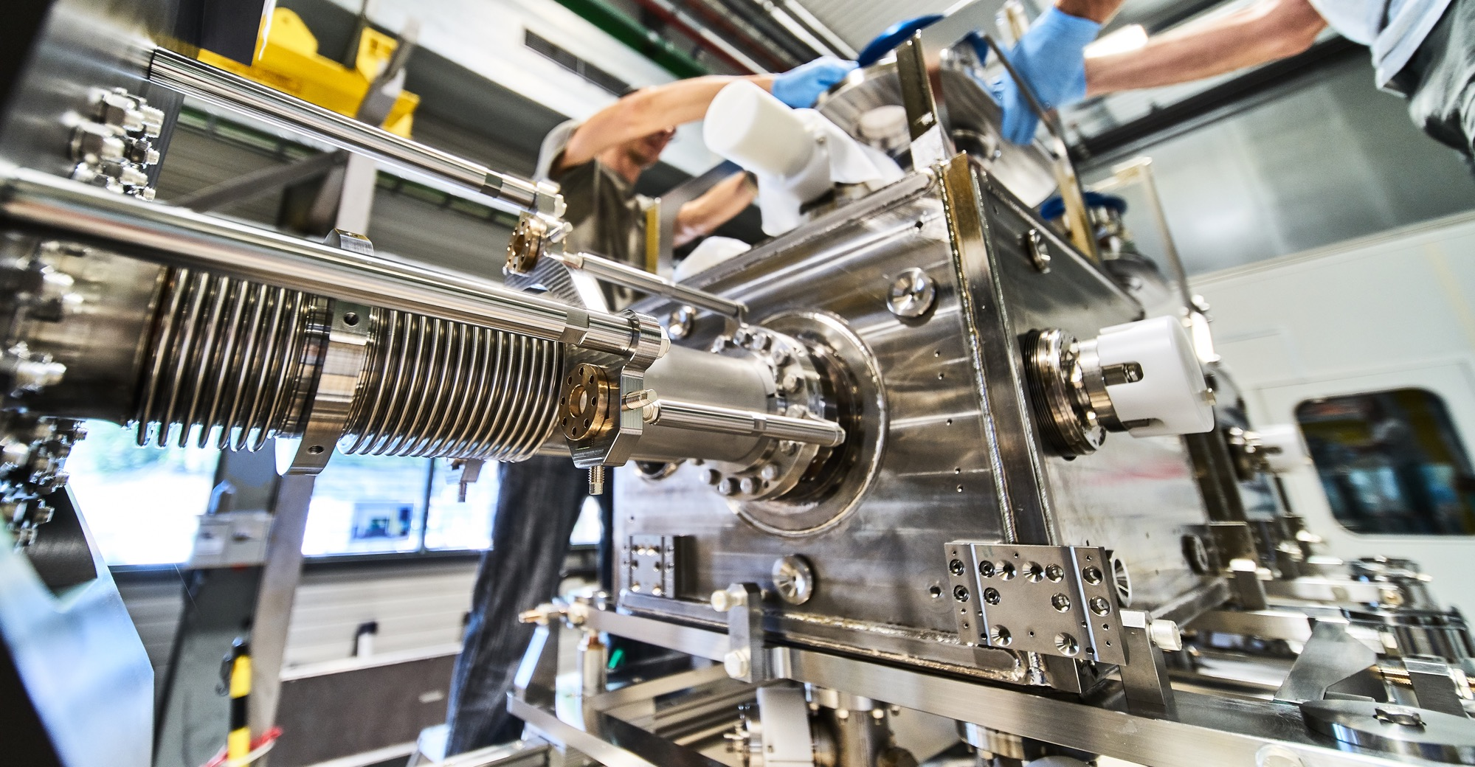
Sections
Services, process Excellence, communication (SE)
Orders, Stores and BCO (OS)
Supplies >50kCHF (SU)
Civil Engineering, FCC and outreach (CE)
Cooperation btw sections

Slide 4
Services, Process Excellence, Communication (SE)
Services
Excellence
Communication
Industrial Services
Temporary labour office
External service
Insurances
Pension Fund
Concessions on site
Responsible procurement
Process standardization:
Training
Templates
Update procedures
…
First level legal advice
Trend analysis
Annual procurement report
Social media (LinkedIn)
Web page content and maintenance
Logo approval

Slide 5
Orders, Stores and BCO (OS)
Orders <50kCHF
Standardisation
Reporting
BCO
Across all sections (except DL and OSVCs)
Establish a policy for standardized products
Requests from stakeholders
Supplier DB
Stores no amount limit
Increase the number of blanket order contracts or to decrease the number of small orders treated via DAIs
Procurement for Stores
Introduce new ways of procuring standardized products

Slide 6
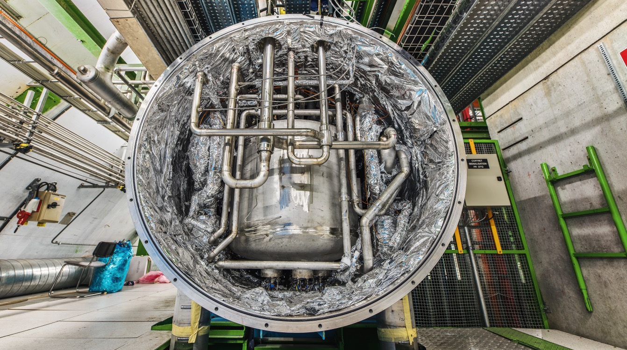
Supplies>50kCHF (SU)
PO specialized by categories
DO>50kCHF for all Procurement codes for supplies (excluding services)
MS/IT (excluding other sections specialties and DUNE/Dark Side projects)
Department contact for each Dept (except SCE, HSE)
R&D Collaboration agreements

Slide 7
Civil Engineering, FCC and outreach (CE)
Civil engineering and renovation contracts
Outreach
FCC coordination of activities
Expert in FIDIC contracts
Policy, strategy related to civil engineering contracts
CFU of civil engineering contracts
Works for all procurement codes
CE consultancy
Liaison with ILOs
Industry events
Coordination of industry request to participate in fairs, road trips, etc.
Strategic advice, early positioning of Procurement Service
Coordination of first procurements

Slide 8
Cheffe des Achats (Cristina Lara)
deputy: Charles Carayon
Orders <50kCHF, Stores (Simon Guerri dall’Oro)
Adam Tuwebti
Arielle Gaidon
Dominique Trolliet
Kilian Bozonet
Merethe Olafsen
Mihaela Palimaru
Steeve Jourdan
Civil Engineering, FCC and outreach
(Adam Horridge)
Aneta Sabanovic
Sandrine Magnan
LD replacing Jérôme
Services >50kCHF , Process Excellence, Communication
(Charles Carayon)
Anthony Veyret
Enrico Cennini
Eva Vordogianni
Josephine Bengtsson
Miriam Cordero
Sebastien Sonnerat
Veronique Angelini
New Quest (to replace Anna)
New LD (to replace Lisa)
Supplies >50kCHF
(Josh Davison)
Andrea Musso
Alvaro Lecinana
Charles Parmentier
Jessica Metcalfe
Floris Bonthond
Julia Bentchikou
Nordine Azizi
Gloria García
New Grad(s)
New structure
Alexandre Tabary
Aurlane Silly
Camila Villaplana
Emeline Lesage
Bjorn Jensen
Fatima Najeh
Hiba Gerster
Sybille Salter
(Jérôme Pierlot
Lisa Bellini-Devictor
Anna Rayson)
DOIT+Utilities+MICE

