Slide 1
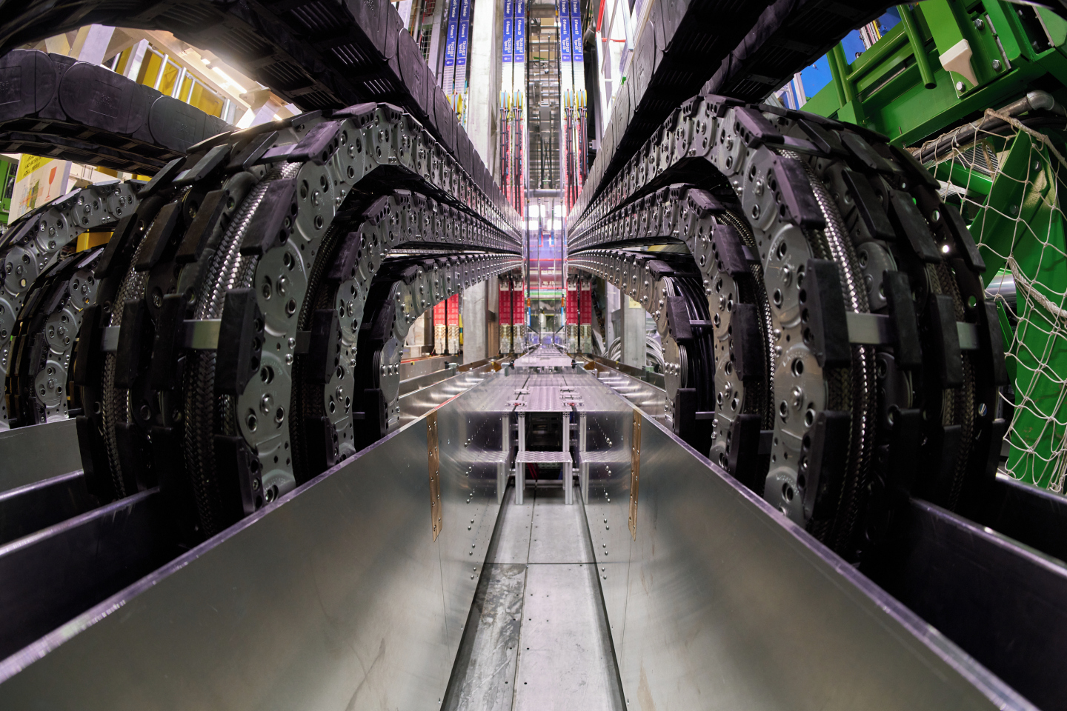
IPT-PI Group meeting
13 March 2025

Slide 2

AGENDA
Newcomers / team changes (Cristina)
2024 procurement report (Cristina)
IT category analysis (Josh)
CERP - Supplier engagement survey (Valeria/Enrico)
BCO corner (Simon)
New D&B procedure (Fella)
New minute (Kraljic type) & logbook (Charles)
AOB

Slide 3
NEWCOMERS & TEAM CHANGES
Cristina Lara
March 2025

Slide 4

PI-CE
Antoine Calmes (1/3)

Slide 5
2024 PROCUREMENT REPORT
Antoine Calmes
Antoine Calmes
Antoine Calmes
Cristina Lara
March 2025

Slide 6

Procurement 2024 - Figures
10.24 MCHF
In savings
32’000
26'500
31’700
Suppliers
orders placed
orders placed on the
CERN Stores
260
62
Contracts signed
R&D collaboration agreements
129
118
Price inquiries above 50k CHF
Invitations to Tender

Slide 7
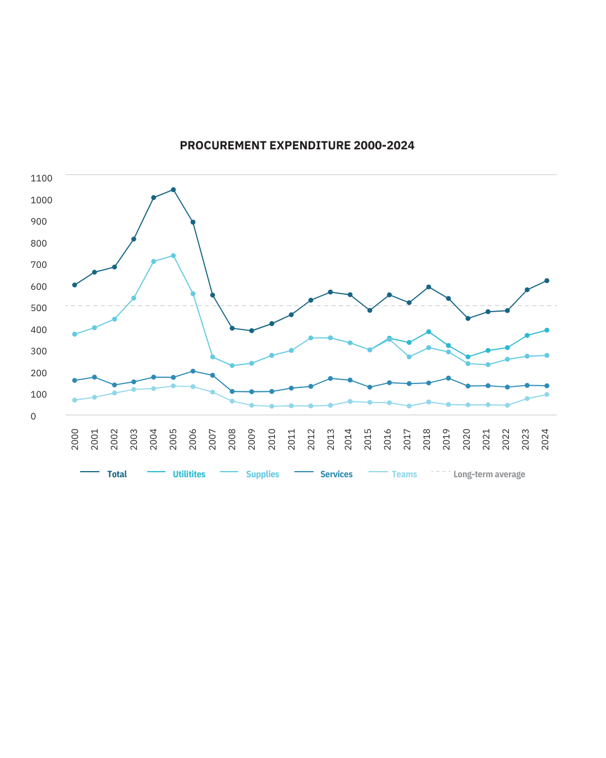
Procurement expenses over time
7% increase wrt 2023
613MCHF

Slide 8
(279MCHF spent in 2024 – CERN budget only*)
What we buy (Supplies)
*Excluding visiting research teams and collaborations

Slide 9
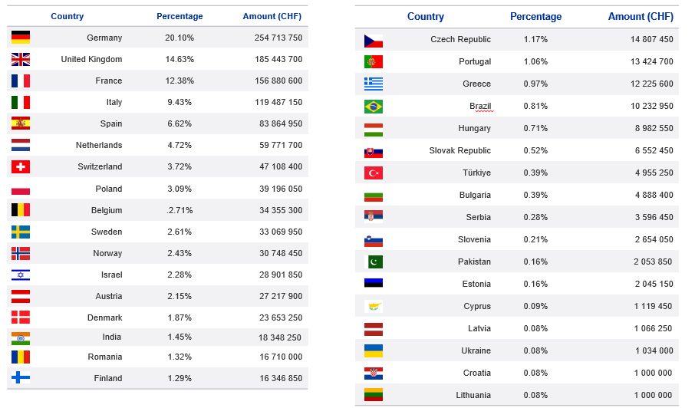
Importance of industrial return
Yearly Budget (contributions 2025)*
Notes:
Why?
CERN is accountable to the taxpayers of its Member States whose money is being spent.
Member States rightfully expect that their financial contribution to the CERN budget translates into contracts for their own industry.

Slide 10
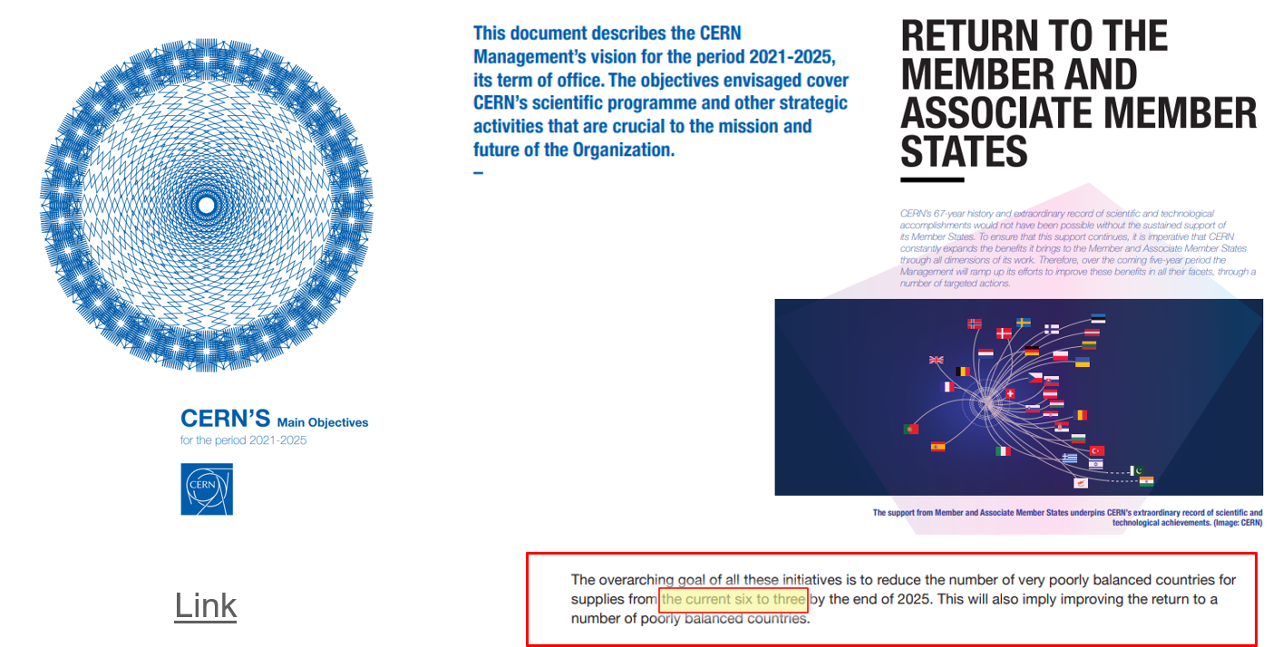
Importance of industrial return
Notes:
Why?
CERN is accountable to the taxpayers of its Member States whose money is being spent.
Member States rightfully expect that their financial contribution to the CERN budget translates into contracts for their own industry.

Slide 11
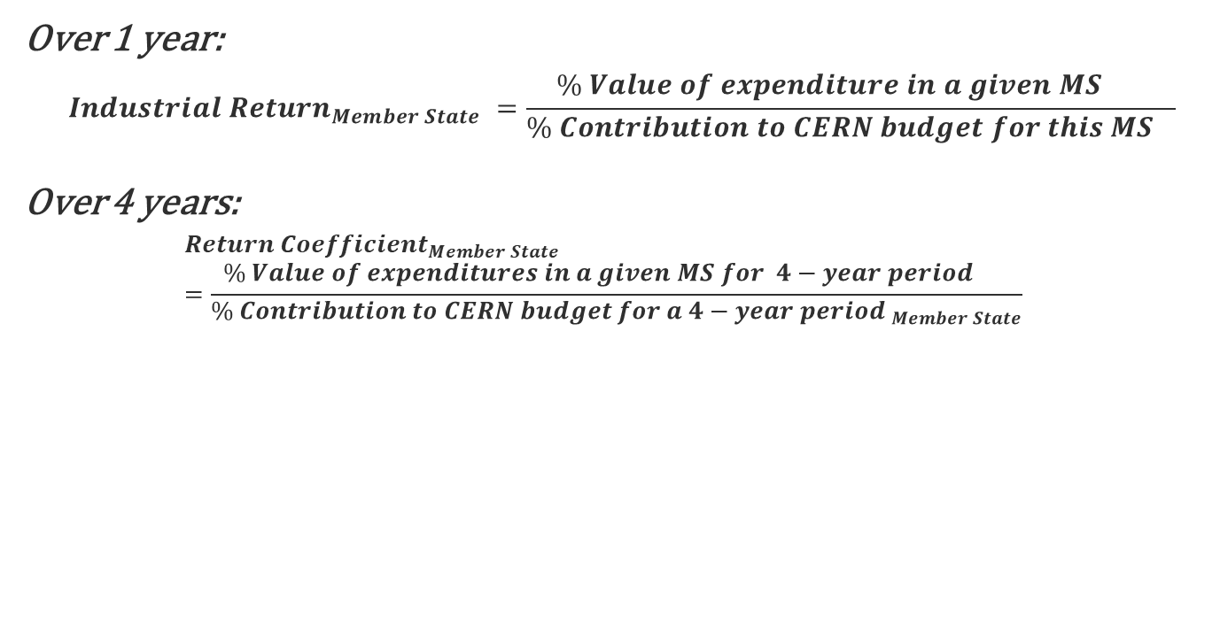
Industrial return & Return coefficient for Supply contracts
Over 1 year:
$${Industrial Return}_{Member State} =\frac{{{\% Value of expenditure in a given MS}^{}}_{}}{{\% Contribution to CERN budget for this MS}_{}}$$
Over 4 years:
$${Return Coefficient}_{Member State}=\frac{{{\% Value of expenditures in a given MS for 4−year period}^{}}_{}}{{\% Contribution to CERN budget for a 4−year period }_{Member State}}$$
* Excludes:
Orders < 2kCHF
Industrial Services
Utilities
Funded by external funds
Non- Member State orders
RETURN COEFFICIENT defines the Member State’s status:
<1.0: Poorly balanced
≥1.0 or more: Well balanced
AMS has reached its ceiling: Well balanced

Slide 12
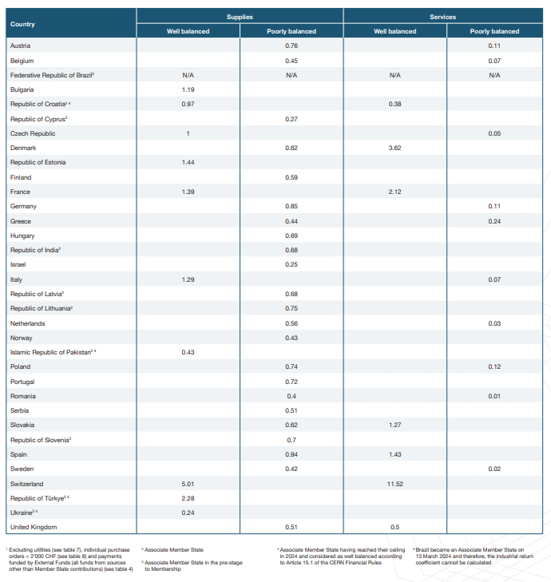
N.A. as Brazil has not been a CERN AMS for 4 years
re
Reached its ceiling in 2024, shall be considered as well balanced

Slide 13
Poorly balanced Member States (Supplies)
(1st March 2025 – 28 February 2026, based on the previous 4 calendar years)
2021
21% of contributions had IR<0.4
6 countries
2024
2.4% of contributions had IR<0.4
2 countries
Well Balanced (≥1) | Poorly Balanced (0 ≥ x < 1)
Bulgaria Croatia* Czech Republic Estonia France Italy Pakistan* Switzerland Türkiye* Ukraine* | Austria Belgium Brazil* Cyprus* Denmark Finland Germany Greece Hungary India Israel Latvia* | Lithuania* Netherlands Norway Poland Portugal Romania Serbia Slovak Republic Slovenia* Spain Sweden United Kingdom
7 countries WB in 2023
10 countries WB in 2024
Brazil status cannot be calculated as they join less than 4 years ago
*Associate Member State or Associate Member State in pre-stage of membership
Note: Brazil joined as an Associate Member State on 13 March 2024

Slide 14
2025 main focus areas for IR (updated on 1st March)
Brazil
Israel
Cyprus
Norway
Serbia
~1.18MCHF
~2.9MCHF
~100kCHF
~1.85MCHF
~230kCHF

Slide 15
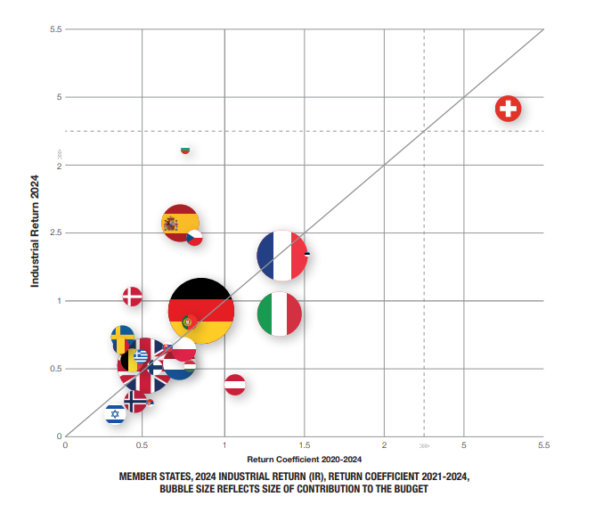
New way to present IR (MS)

Slide 16
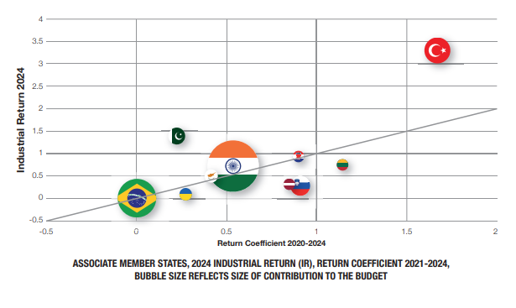
New way to present IR (AMS)

Slide 17
Limited Tendering (LT)
« Limited tendering is foreseen by the CERN Procurement Rules to improve the industrial return of the twelve Member States with the lowest industrial return. »
Conditions
12 Member States with the lowest industrial return coefficient for supply contracts
Used in case where there is sufficient competition
ILO can ask to add firms, provided they can provide supplies from countries eligible to LT

Slide 18
Limited tendering
(guideline: used if at least 6 firms identified)
Currently eligible countries – updated on a permanent basis:
Belgium
Brazil
Cyprus
Greece
Israel
The Netherlands Norway
Pakistan
Romania
Serbia
Sweden
United kingdom
How is it possible that Pakistan is both eligible to LT and WB?

Slide 19
IT category analysis
Josh Davison
March 2025

Slide 20
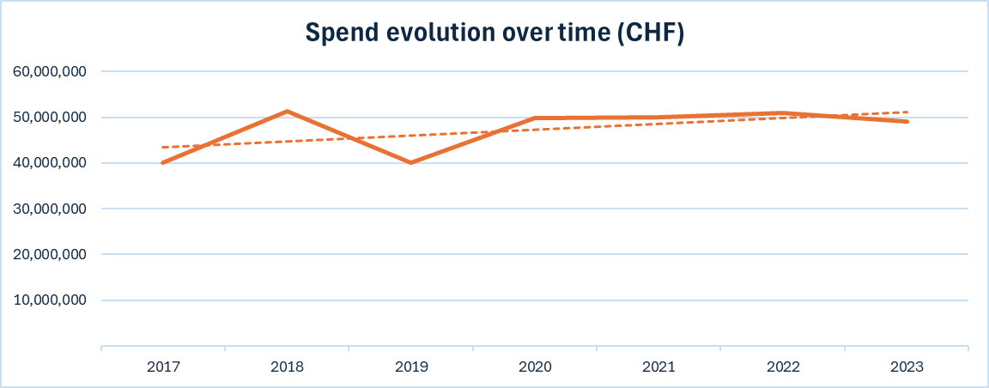
Key characteristics of the IT category
Centralised, recurring spend split across two main categories
50
M CHF/year
83%
covered by contracts
322
contracts
50
M CHF/year
5000
orders/year
757
suppliers over 3 years
Average annual expenditure 2021-2023 in CHF from Pentaho
Notes:
Procurement of IT done by all departments, with efforts to centralise in IT and SCE
NB the above data is based on procurement codes, which is not 100% reliable. For example, several purchases for security systems for EN-AA are included in the IT spend.
Consultancy and stores spend handled by PI-SE and PI-OS (approx 1.5 MCHF/year each)

Slide 21
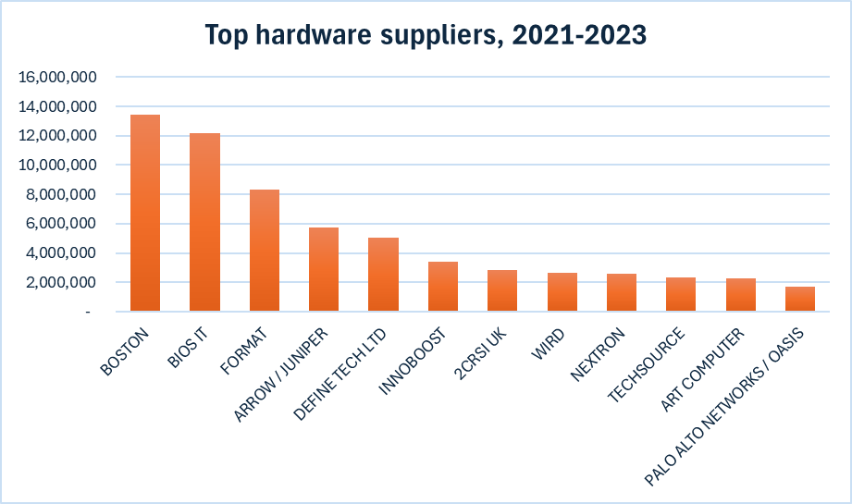
IT hardware overview
7 distinct sub-categories, dominated by spend on servers and storage
35
M CHF/year
Average annual expenditure 2021-2023 in CHF from Pentaho
Server contracts retendered every 1-2 years, usually on Limited Tendering
Network contracts retendered every 8-10 years, no Member State suppliers
High technical dependency on IBM for tape drives, contract is single source
Very few one-off procurements, PAN firewall is the only one in the graph to the left

Slide 22
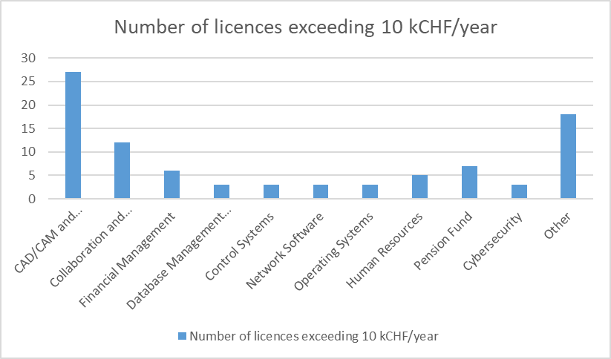
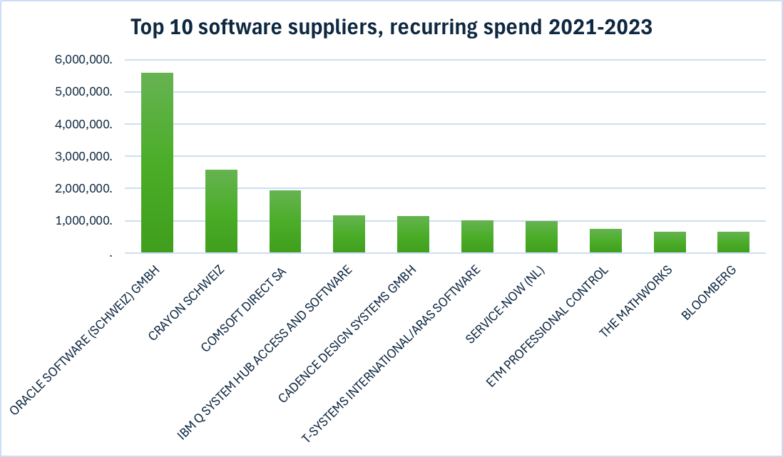
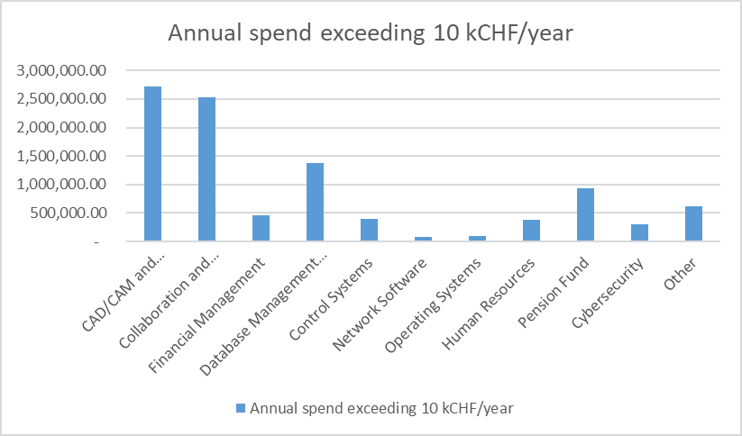
IT software overview
Low total annual spend but very high risk exposure, with costs expected to rise in coming years
Almost all software contracts are renewed on a single source basis
High US presence in country of origin
If CERN loses all discounts, the total cost is > 100 MCHF/year vs. current costs of 10 MCHF/year

Slide 23
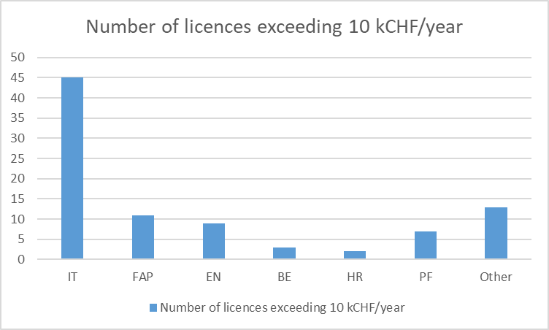
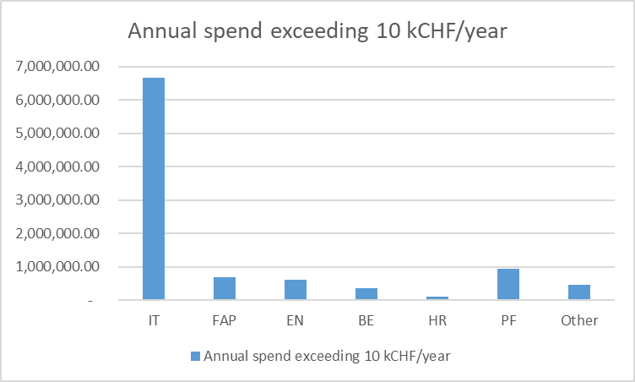
SW spend by Department
+ estimated 100-150 licences < 10 kCHF/year

Slide 24
Upcoming likely or known SW price increases
Autodesk: expected to increase approx. 100% to ~450 kCHF/year from August 2025
Adobe: price increase expected January 2027 (current costs = 25 kCHF) (academic licence will disappear) x 3
CATIA: current cost ~40kCHF/year, Dassault has restricted academic status on other products
Intel Parallel Studio XE: From Jan. 2027, large price increase announced (academic licence will disappear)
Google: price validity until March 2027
ServiceNow: price increase ~50% (to 750 kCHF) expected from September 2027

Slide 25


Highly risky SW contracts and possible exposure
Contract | Current costs/year | Estimated exposure (costs/year) | Level of dependence | Likelihood of losing discounts/access | Risk rating
Cadence | 600 kCHF | 13.5 MCHF | High | High
Oracle | 1.2 MCHF | 24 MCHF | High | Medium
WinCC OA | 285 kCHF | Unknown | High | Medium
Qualiac | 110 kCHF | Unknown | High | Medium
IBM Spectrum Protect | 90 kCHF | 4.5 MCHF | High | Medium
RHEL | 60 kCHF | Unknown | Medium-high | High
GitLab | 93 kCHF | 20 MCHF | Medium-high | Low
ESRI | 95 kCHF | 10 MCHF | Medium | High

Slide 26
What can we do?
Actions already taken
Recommendations
Long term contracts where we have long term dependencies
Choose more protective and controllable licence models wherever they are available
Localised examples of good vendor management and work started in IPT to develop contract and supplier management policies
Proactive and forward-looking IT procurement plan
Some examples of good coordination between user groups (e.g. CAEC)
Hardware procurements highly centralised and standardised
Clarify and leverage the role of STEPS in the procurement process to reduce ‘rogue spend’ on software
Empower a category manager to define and manage strategic suppliers and reject rogue procurement requests
Operationalise the eligibility framework to restrict access to software where appropriate
Implement vendor management practices in line with new IPT policies on contract and supplier relationship management (= time, resource and sponsorship)
Continue to invest in collaborations with contractors on new technologies (leverage OpenLab, cloud, AI, quantum, etc)
Further standardise peripheral equipment used at CERN in order to consolidate spend into a smaller number of contracts

Slide 27
SWOT Analysis: Hardware
Strengths
Relatively centralised procurement (in IT or SCE)
Technical teams very open to Procurement proposals, limited tendering procedures, etc
Very good, mature specifications
Very large tenders foreseen for equipment needed for run 4: industrial return opportunity
Opportunities
High degree of competition for CPU/GPU and disk storage contracts: low prices, good IR, sustainability
Technological trend towards cloud computing that could in the future become competitive with CERN’s on-site computing resources
Consolidation of peripherals and device contracts (managed in SCE)
Weaknesses
Strong technical dependence on some suppliers (IBM)
Lack of openness to externalising hardware
Transactional relationship between CERN and key market players (Nvidia, Supermicro, IBM)
Sometimes poor visibility on future needs from IT groups and experiments
Threats
Increasingly monopolistic position of Nvidia (risk of price increases and opaque software costs on Nvidia GPU platforms)
IBM monopoly on tape readers and risk of obsolescence or price increases
Market tightenings due to export control on Chinese products
Increasing scrutiny and paperwork on end user rights from US companies such as NVIDIA and Ampere, without which deliveries are withheld

Slide 28
SWOT Analysis: Software
Strengths
Very low prices on many SW contracts
CERN’s attractivity as a client in some cases
Centralisation and close follow up by Procurement
Opportunities
Increased digitalisation and automation can save time and money to CERN
Growing awareness of risks inside CERN, opportunity to implement a vendor management approach to managing risks
Leverage STEPS as a coordinating body for management of the SW category
Define standard costs on which strategic decisions can be made for make vs buy
Weaknesses
Generally not centralised, each department buys the software it wants
Very painful and lengthy procurement process (procurement, ODP, IT security, Legal all involved)
For many contracts, CERN is a small fish in a big pond
Lack of visibility of the full software portfolio (free SW)
Lack of willingness to change, limited investment in “plan B”
Fragmented, dispersed user base
Threats
Exposure to non-compliance with licence conditions or use of illegally obtained software
Software prices expected to increase on average by 40% by 2027 globally (source: Gartner)
Huge risk exposure to increased prices
Growing attention on export control: significant operational, reputational and financial impact in case of non-compliance

Slide 29

CERP – supplier engagement survey
Valeria Galmarini / Enrico Cennini
March 2025

Slide 30
Agenda
Scope and Data Collected
Methodology
Results: matrix by procurement code families
Overall results
Action plan proposal

Slide 31
Scope and Data Collected

Slide 32
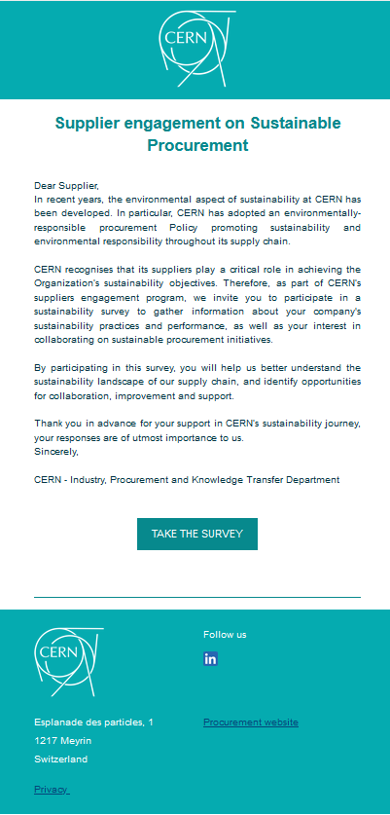

Scope and data collected
Identify maturity of suppliers on sustainability level
Identify to what degree suppliers are willing to collaborate
WHY
WHO
Sent to 267 suppliers from all procurement code families
Questionnaire with targeted sustainability questions
WHAT
Weekly automated emailing through SpotlerMail+
HOW
Response Rate
87 out of 267 suppliers among 9 procurement code families
= 32.5%

Slide 33
Family Codes and Response Rates
% REPLIES BY INDUSTRY
Note: some family codes have not replied

Slide 34
Methodology

Slide 35












The survey
Questions were asked to suppliers to assess and score their level of:
Maturity
Weight
on score
Engagement
Weight
on score
Does your company currently have a sustainability/environmental policy or program in place?
10%
Would you be interested in collaborating with CERN to calculate these emissions?
50%
Does your company hold any certifications related to environmental or sustainability practices?
10%
Does your company have initiatives in place to encourage sustainability/environmental practices across its supply chain?
15%
Would your company be open to setting targets for reducing the carbon footprint of its supplies or services provided to CERN?
20%
Does your company measure its carbon footprint?
20%
Does your company publish a report on its carbon footprint?
15%
Is your firm able to provide data on CO2 emissions specifically related to services or products provided to CERN contracts?
10%
Length of relationship with CERN in years
15%
Has your company defined specific sustainability/environmental goals for the next 5 years?
20%
Yearly average contract amount in the last 3 years
15%

Slide 36

The matrix
Matrix key
II QUADRANT
III QUADRANT
Maturity of the suppliers’ strategy towards sustainability
Engagement of the supplier on improving its sustainability approach
I
Supplier not mature, nor willing to engage
II
Supplier not mature, but willing to engage
I QUADRANT
IV QUADRANT
III
Supplier mature and willing to engage
IV
Supplier mature, but not willing to engage
To develop ad hoc sustainability and engagement action plans for suppliers based on their assigned quadrant

Slide 37
Results
Matrix by procurement code families
MATURITY & WILLINGNESS TO ENGAGE WITH CERN

Slide 38

Industry matrix 1/9
CIVIL ENGINEERING, BUILDING & TECHNICAL SERVICES
II
III
FINDINGS
ASSESSED: 14 suppliers
I QUADRANT – not mature, nor willing to engage
21.4% of suppliers
I
IV
II QUADRANT – not mature, but willing to engage
57.1% majority of suppliers
III QUADRANT – mature and willing to engage
14.3% of suppliers
IV QUADRANT – mature, but not willing to engage
7.1% of suppliers

Slide 39
Industry matrix 2/9
ELECTRICAL ENGINEERING & MAGNETS
II
III
FINDINGS
ASSESSED: 7 suppliers
I QUADRANT – not mature, nor willing to engage
0% of suppliers
IV
II QUADRANT – not mature, but willing to engage
I
0% of suppliers
III QUADRANT – mature and willing to engage
42.9% of suppliers
IV QUADRANT – mature, but not willing to engage
57.1% majority of suppliers

Slide 40
Industry matrix 3/9
ELECTRONICS and RADIOFREQUENCY
II
III
FINDINGS
ASSESSED: 8 suppliers
I QUADRANT – not mature, nor willing to engage
25% of suppliers
I
IV
II QUADRANT – not mature, but willing to engage
12.5% of suppliers
III QUADRANT – mature and willing to engage
37.5% majority of suppliers
IV QUADRANT – mature, but not willing to engage
25% of suppliers

Slide 41
Industry matrix 4/9
INFORMATION TECHNOLOGY
II
III
FINDINGS
ASSESSED: 6 suppliers
I QUADRANT – not mature, nor willing to engage
0% of suppliers
II QUADRANT – not mature, but willing to engage
I
IV
33.3% of suppliers
III QUADRANT – mature and willing to engage
50% of suppliers
IV QUADRANT – mature, but not willing to engage
16.7% of suppliers

Slide 42
Industry matrix 5/9
MECHANICAL ENGINEERING AND RAW MATERIALS
II
III
FINDINGS
ASSESSED: 15 suppliers
I QUADRANT – not mature, nor willing to engage
26.7% of suppliers
I
II QUADRANT – not mature, but willing to engage
IV
33.3% majority of suppliers
III QUADRANT – mature and willing to engage
26.7% of suppliers
IV QUADRANT – mature, but not willing to engage
13.3% of suppliers

Slide 43
Industry matrix 6/9
VACUUM AND LOW TEMPERATURE MATRIX
III
FINDINGS
II
ASSESSED: 6 suppliers
I QUADRANT – not mature, nor willing to engage
16.7% of suppliers
II QUADRANT – not mature, but willing to engage
I
IV
16.7% of suppliers
III QUADRANT – mature and willing to engage
50% majority of suppliers
IV QUADRANT – mature, but not willing to engage
16.7% of suppliers

Slide 44
Industry matrix 7/9
OPTICS AND PHOTONICS
II
III
FINDINGS
ASSESSED: 1 supplier
I QUADRANT – not mature, nor willing to engage
100% of suppliers
II QUADRANT – not mature, but willing to engage
I
IV
0% of suppliers
III QUADRANT – mature and willing to engage
0% of suppliers
IV QUADRANT – mature, but not willing to engage
0% of suppliers

Slide 45
Industry matrix 8/9
OFFICE SUPPLY, TRAINING & COMMUNICATION
II
III
FINDINGS
ASSESSED: 3 suppliers
I QUADRANT – not mature, nor willing to engage
66.7% majority of suppliers
I
II QUADRANT – not mature, but willing to engage
IV
0% of suppliers
III QUADRANT – mature and willing to engage
0% of suppliers
IV QUADRANT – mature, but not willing to engage
33.3% majority of suppliers

Slide 46
Industry matrix 9/9
SERVICES AT CERN
FINDINGS
III
ASSESSED: 23 suppliers
I QUADRANT – not mature, nor willing to engage
8.7% of suppliers
II
II QUADRANT – not mature, but willing to engage
17.4% of suppliers
III QUADRANT – mature and willing to engage
56.5% majority of suppliers
IV QUADRANT – mature, but not willing to engage
17.4% of suppliers
I
IV

Slide 47
Overall results

Slide 48

Overall matrix 1/2
Average scores by procurement family code
II
III
Considerations
Partial image of the status of the supply chain
Broad and indicative vision on where we are now
Food for thoughts on what to do next!
Engagement
I
IV
Maturity

Slide 49

Overall matrix 2/2
Overall % of suppliers by quadrant
To recap
II
III
The overall majority of suppliers are willing to engage with CERN
The lowest % are not interest to collaborate with CERN
24.1%
38.5%
Engagement
I
IV
But! Let’s not forget:
The lack of interest might depend on company’s resource
If escalated internally, we might receive different replies
18.1%
19.3%
Maturity

Slide 50
Action plan proposal

Slide 51




Actions proposal
II
III
NOT MATURE, BUT WILLING TO ENGAGE
MATURE AND WILLING TO ENGAGE
SUPPORT & MENTORSHIP
COLLABORATION & SCALE IMPACT
I
IV
NOT MATURE, NOR WILLING TO ENGAGE
MATURE, BUT NOT WILLING TO ENGAGE
AWARENESS & MONITORING
UNDERSTAND & LEARN

Slide 52




Stakeholders Engagement
Next steps
INTERNAL ENGAGEMENT
EXTERNAL ENGAGEMENT
PROCUREMENT TEAM
TECHNICAL OFFICERS
SUPPLIERS
Set up ad hoc meetings with Category Managers to deep dive into survey results.
Share supplier-specific insights
from past engagement experiences.
Engage with Communication Officer to enlarge suppliers’ scope + plan comms
Identify challenges & motivations
to improve collaboration.
Set up ad hoc meetings with Category Technical Officers to deep dive into survey results.
Share supplier-specific insights
from past engagement experiences.
Identify challenges & motivations
to improve collaboration.
Engage with identified relevant suppliers.
Engagement strategy will vary based on procurement family and quadrant of reference from the matrix analysis.
Engagement could be for the short,
medium or long term.
COLLABORATION

Slide 53
Expected approach and next steps
Supplier engagement should not be based solely on the matrix results but also consider:
Why?
Suppliers in the same quadrant of the matrix may require different strategies based on:
Their Procurement family code;
CERN’s experience working with them.
Tailored approach needed to engage suppliers effectively.
The approach will be decided on case-by-case basis in collaboration with technical and procurement officers.
Matrix Results
Procurement family
Comprehensive
Approach
Supplier Knowledge
Make the most out of all knowledge gathered on suppliers to maximize engagement and strategic sustainability results in the long-term.

Slide 54


Progress against targets
Regular Data Collection & Reporting
Leverage digital tools dashboards to track real-time data and report.
Feedback & Continuous Engagement
Provide tailored action plans for suppliers based on progress.
Organize workshops or training sessions to share best practices.
Recognize & incentivize high-performing suppliers.
Categorize Suppliers Based on Progress
Leaders – Exceeding targets and actively innovating.
Compliant – Meeting minimum sustainability standards.
Starting – Not progressing; require engagement & support.
Sustainable Procurement Targets for 2025
At least 50 suppliers assessed on their sustainability performance each year.
At least 25 out of the top-emitting suppliers report CO2 emissions of their activities for CERN by the end of 2025.
2 workshops organized.

Slide 55




So…
WE NEED YOUR HELP!
NB only ever smiling picture of Mr.Cennini

Slide 56

THANK Y U!

Slide 57
BCO - update
Simon Guerri dall’Oro (IPT-PI-OS)
January 2024

Slide 58
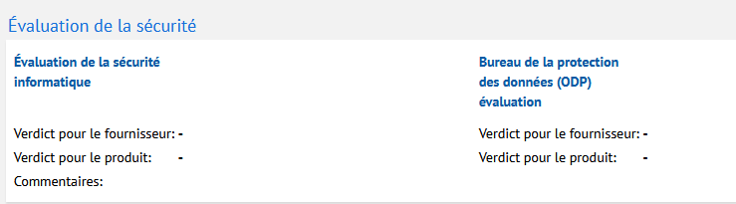
DAI (EDH) update : IT Security Assessment
The EDH DAI process includes a new mandatory question for the Technical Contact :
“Does the DAI include any software, cloud services, or other supplies/services that could raise concerns related to Data Privacy or IT Security?*”
When the answer is YES, a new signature workflow has been introduced, going directly to the Cloud Officer.
As Procurement Officer (IPT-PI), you have nothing to do.

Slide 59
RDOS (EDH) update
It is now mandatory to add one file to the RDOS:
List of Firms
DO Memorandum
MS Memorandum
Supplier Code of Conduct is added in the list of document to be dispatched

Slide 60
+ Coming soon (~April)
CORR (EDH) update for Collaboration Agreement (ONLY)
Mandatory justifications concerning the selection of the institute, and why a collaboration agreement was chosen instead of a contract
Mandatory risk matrix
New fields (by TO):
  CERN Safety Officer
  Institute Safety Officer
Signature workflow by
  TO’s management (SL + DH)
  Procurement Officer (and SL + GL if required) for KR, KE, KM
Legal Service in copy for information at the end of the workflow
Identification of Collaboration Agreement in Qualiac (in progress Q2 2025)

Slide 61
S2P Project – FAP/BC
Source-to-Pay (S2P) This process covers the entire procurement cycle from identifying a need (Source) to making the payment (Pay). It includes sourcing, procurement, ordering, receiving, invoicing, and payment.
Achieved : We worked with a Consultant (January / February 2025) to assess the possibilities for CERN to integrate a S2 P solution (or part of it).
Thank you for your participation ! Adam, Alvaro, Andrea, Anthony, Charles, Cristina, Davide, Fella, Josh, Julia, Nordine.
Conclusion was presented to CERN on 7th of March with several (interesting and challenging) options.
Next steps (target June 2025): CERN internal discussions
  FAP-BC : technical analysis
  IPT-PI : benefits vs risks
  Management : costs vs risks

Slide 62

And the one you’r all asking me !!
CHAT GPT
Order signed
Limited number of licences (50 for all FHR) to be distributed soon
Next meeting Monday

Slide 63
New D&B procedure
Bethan Roberts
March 2025

Slide 64









A centralised way to request a D&B (Dun & Bradstreet) report
Old process
NEW process
Procurement officers
D&B site
Over-consumption (duplicate reports)
Procurement officers
Request
via
Confluence
Supplier DB
D&B site
Reports available in Confluence
Each procurement officer was logging into D&B to download a report.
A centralised way for Procurement officers to request a D&B report.
The procedure was manually updated with the D&B log-in and password.
No log-in or password required in Confluence.
In 2024, several duplicated reports were requested, resulting in additional costs for the Procurement service.
All requested reports are available on the Confluence page, resulting in no more duplicates.

Slide 65
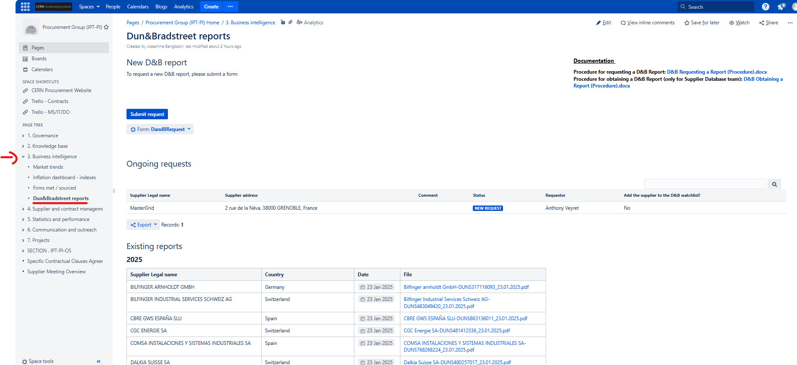
Link: https://confluence.cern.ch/pages/viewpage.action?pageId=526224629

Slide 66
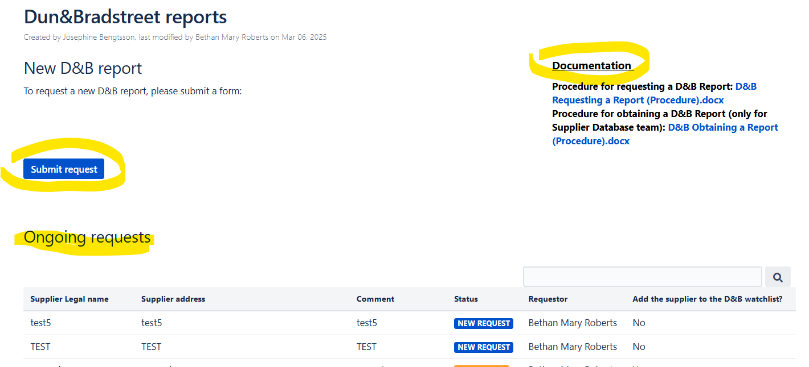
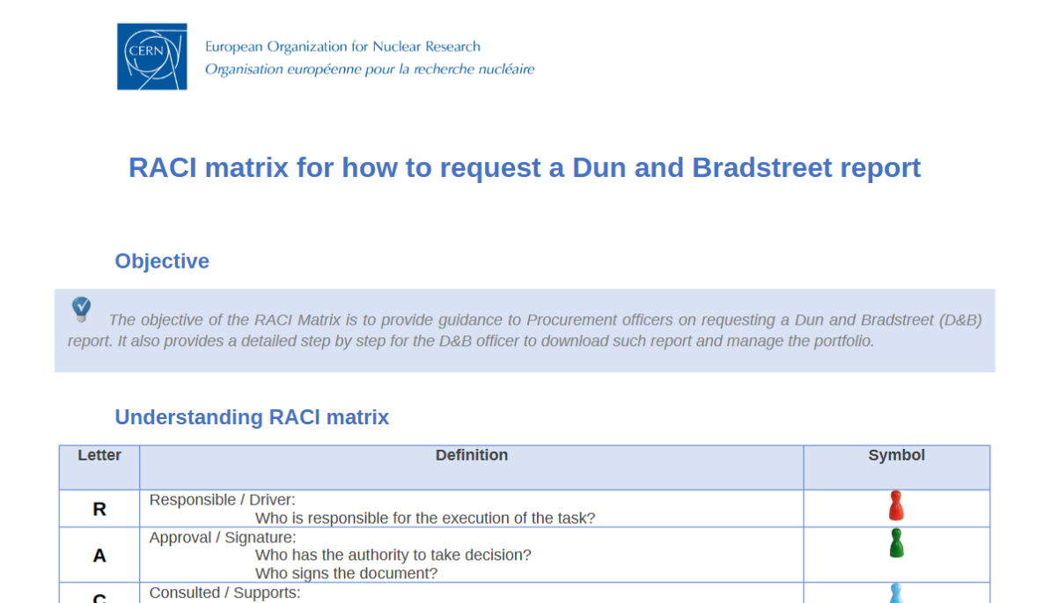

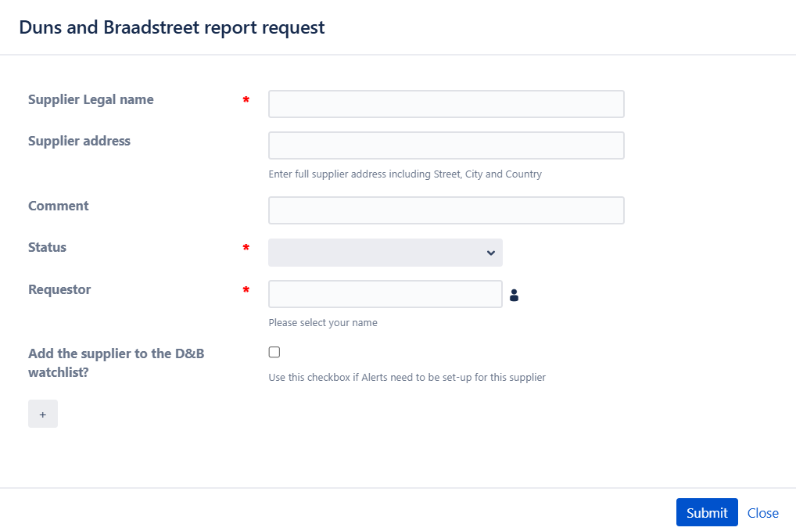
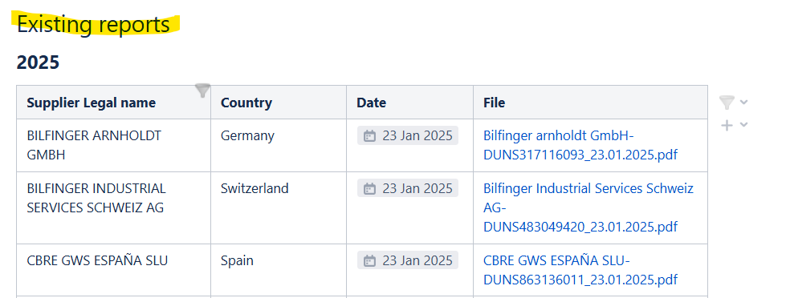
A centralised way to request a D&B (Dun & Bradstreet) report
Demo time

Slide 67
New minute on critical contracts & logbook
Charles Carayon
March 2025

Slide 68
Internal audit
Strategic contracts to be followed-up closely: confluence page
 |  |  |  | Kraljic Financial Impact | Kraljic Supply Risk |  |  | Kraljic TYPE
Ref | Description | Suppliers | Comm1 | 1 = 1MCHF per year, 10 >=10MCHF to be adapted case by case | how critical is this supply? Impact if failure? | Likelihood of failure? | Avg. Supply risk | Type
X302/IT | Microsoft EES Contract | CRAYON SCHWEIZ | Metcalfe, Jessica | 2 | 6 | 1 | 7 | Bottleneck
X146/IT | Oracle Licence renewal | ORACLE SOFTWARE (SCHWEIZ) GMBH | Metcalfe, Jessica | 1 | 10 | 1 | 7 | Bottleneck
U014/EN | Supply of electrical energy | EDF - DIRECTION GRANDS COMPTES | Jenssen, Bjorn | 10 | 10 | 1 | 7 | Strategic
U009/EN | Transmission of electricity | RTE | Jenssen, Bjorn | 10 | 10 | 1 | 7 | Strategic
S310/EN | CV maintenance contract | DALKIA | CARAYON, Charles | 4 | 6 | 6 | 6 | Bottleneck
S303/EN | Maintenance of switchboards | Schneider | Veyret, Anthony | 1 | 7 | 5 | 6 | Bottleneck
S278/EN | Maintenance of transformers | Schneider | Veyret, Anthony | 1 | 7 | 5 | 6 | Bottleneck
S262/EN | ELECTRICAL INSTALLATION WORK | COMSA INSTALACIONES Y SISTEMAS INDUSTRIALES SAU | CARAYON, Charles | 10 | 8 | 5 | 7 | Strategic
S236/EN | CV maintenance contract | CBRE GWS TECHNICAL SERVICES | CARAYON, Charles | 4 | 6 | 6 | 6 | Bottleneck
S176/TE | Cryo maintenance and operation | SERCO LIMITED / AIR LIQUIDE ADVANCED TECHNOLOGIES | CARAYON, Charles | 5 | 8 | 3 | 6 | Bottleneck
F812/RCS/LBNF/DUNE | LBNF-DUNE Cold Materials | GABADI | Horridge, Adam | 10 | 8 | 4 | 7 | Strategic
F779&780/TE | HL-LHC Cryogenic Helium Lines | KRIOSYSTEM | Lecinana Soldevilla, Alvaro | 6 | 9 | 7 | 8 | Strategic
F777&778/TE | HL-LHC He Refrigerators P1&P5 | LINDE KRYOTECHNIK AG | Lecinana Soldevilla, Alvaro | 10 | 9 | 2 | 7 | Strategic
F663/TE | Nb3Sn for Hi-Lumi Quadrupoles | BRUKER OST LLC | Bentchikou, Julia | 4 | 10 | 3 | 8 | Bottleneck
B1847/EP | ELV and LV power supplies | CAEN SPA | Azizi, Nourdine | 1 | 8 | 2 | 6 | Bottleneck
B1793/EP | Power supplies for ITk Pixels | WIENER POWER ELECTRONICS, WIENER DE / ISEG DE | Azizi, Nourdine | 3 | 8 | 3 | 6 | Bottleneck
B1727/EP | Power Supply for ATLAS Muons | CAEN SPA | Azizi, Nourdine | 2 | 8 | 2 | 6 | Bottleneck
B1716/EP | Outer Tracker Hybrid Circuits | VALTRONIC TECHNOLOGIES (SUISSE) SA | Azizi, Nourdine | 2 | 8 | 8 | 8 | Bottleneck
B1702/EP | Bump-bonding of Pixel modules | ADVACAM OY / VTT TECHNICAL RESEARCH CENTRE OF FINLAND LTD, ADVAFAB OY | Azizi, Nourdine | 1 | 10 | 6 | 9 | Bottleneck
B1687/TE | Helium Supply at CERN | LINDE GAS SCHWEIZ, LINDE GAS CH / LINDE GMBH | Lecinana Soldevilla, Alvaro | 3 | 7 | 4 | 6 | Bottleneck
B1681/EP | ELV and LV power supplies FOR IT-4492/EP/CMS | WIENER POWER ELECTRONICS | Azizi, Nourdine | 5 | 8 | 4 | 7 | Bottleneck
B1641/BE | High Power RF Grid-tubes | THALES AVS FRANCE SAS | Bentchikou, Julia | 2 | 8 | 2 | 6 | Bottleneck
B1593/EP | Si sensors for CMS HGCal | HAMAMATSU PHOTONICS FR, SWISS OFFICE | Azizi, Nourdine | 5 | 10 | 1 | 7 | Bottleneck
B1592/EP | Silicon sensors for ATLAS/CMS | HAMAMATSU PHOTONICS FR, SWISS OFFICE | Azizi, Nourdine | 1 | 10 | 1 | 7 | Bottleneck
B1591/EP | FRAMEWORK MS - Silicon sensors for ATLAS/CMS | HAMAMATSU PHOTONICS FR, SWISS OFFICE | Azizi, Nourdine | 5 | 10 | 1 | 7 | Bottleneck
B1379/EP | FOUNDRY SERVICES | IMEC VZW | Azizi, Nourdine | 5 | 9 | 4 | 7 | Bottleneck
B1226/EP | LOW VOLTAGE POWER SUPPLIES | CAEN SPA | Azizi, Nourdine | 1 | 8 | 3 | 6 | Bottleneck
B1225/EP | EXTRA LOW VOLTAGE POWER SUPPLY | WIENER POWER ELECTRONICS | Azizi, Nourdine | 1 | 8 | 2 | 6 | Bottleneck
B1215/HSE | PERSONAL DOSIMETERS | MIRION TECHNOLOGIES (RADOS) OY | Metcalfe, Jessica | 0 | 10 | 1 | 7 | Bottleneck
B1186/EP | VMEBUS SUBRACKS | WIENER POWER ELECTRONICS | Azizi, Nourdine | 1 | 8 | 2 | 6 | Bottleneck
B1130A/EN | SIEMENS AUTOMATION PRODUCTS | SIEMENS SCHWEIZ AG | Musso, Andrea | 1 | 8 | 2 | 6 | Bottleneck
B1129/EN | SUPPLY OF SCHNEIDER EQUIPMENT | SCHNEIDER ELECTRIC | Musso, Andrea | 1 | 8 | 2 | 6 | Bottleneck
F830/EP | CMS endcap handling | VSL | Carayon, Charles | 1 | 8 | 4 | 7 | Bottleneck

Slide 69
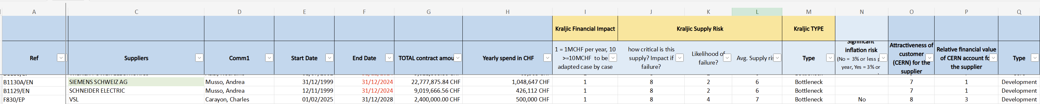
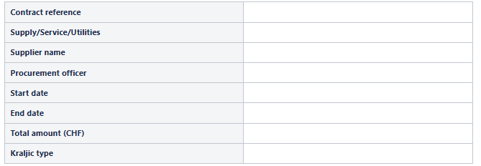
«MINUTE CONTRACT» update and Logbook
When circulating a contract, PO to update the "Kraljic type" fields in the updated version of the "MINUTE CONTRACT":
  Access the dedicated confluence page
  Click and update the excel file available on CERNbox here with the contract information
  Update the template before circulation
Once the "MINUTE CONTRACT" is fully approved, and only for STRATEGIC, BOTTLENECK and SERVICE contracts, or any contract exceeding 10 MCHF the DO-IT team will create the contract on the dedicated confluence logbook, by filling the following information:

Slide 70
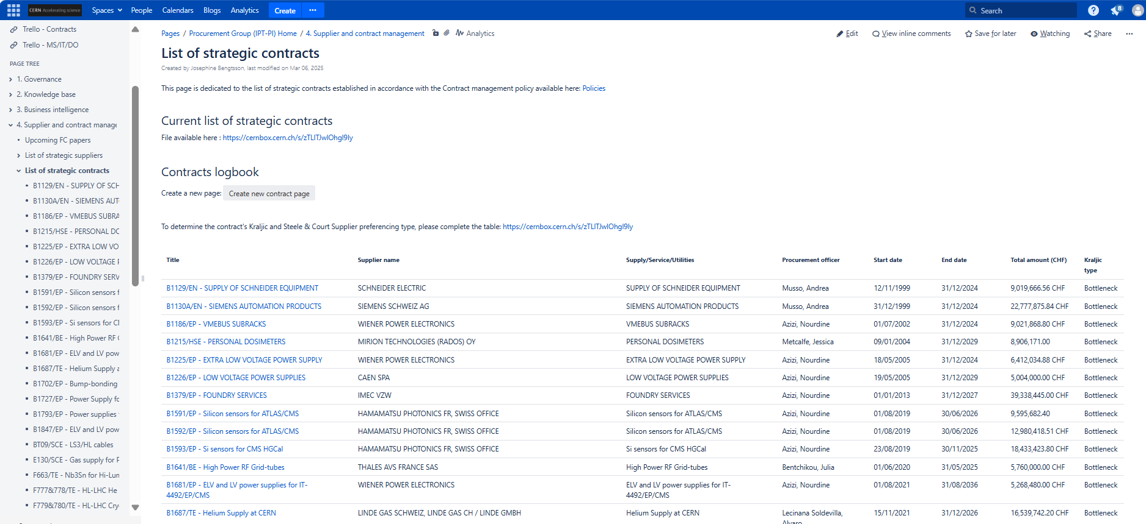
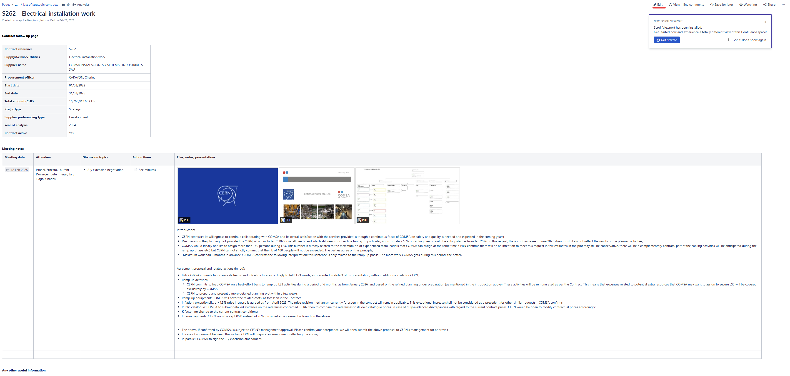
«MINUTE CONTRACT» update and Logbook
Notes:
Coming soon (with policy implementation): for Strategic/bottleneck and S contracts, incl. contracts >10MCHF, POs to update the page (e.g. Main meetings notes, minutes, presentations etc.).
You may use the logbook for all your contracts

Slide 71
Next
Test the logbook – provide feedback
Finalisation of contract management policy

Slide 72
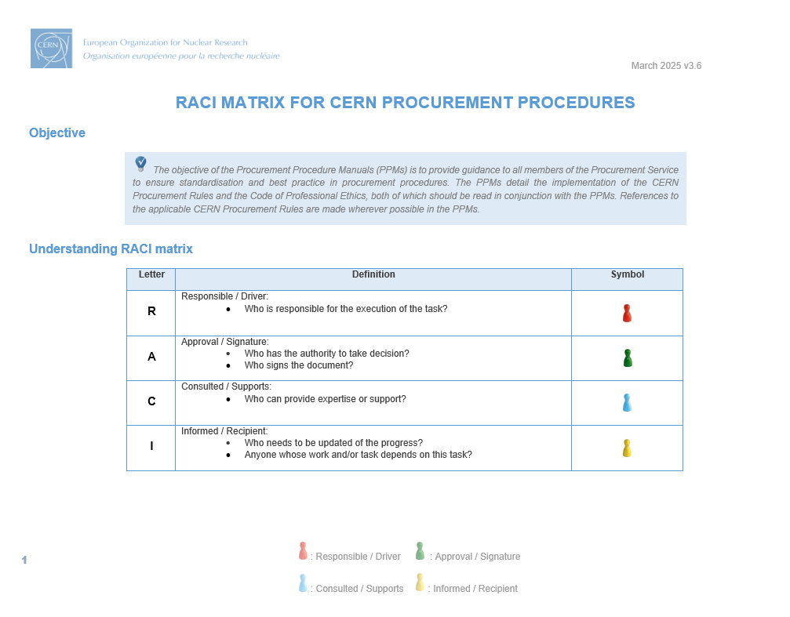

Note
D&B reports – Kraljic contract category & logbook
=> The PPMs were updated !

Slide 73
AOB

Slide 74
AOB
Save the date: ILO forum on 25 March – coffee break at 10.15AM in 4-3-006 (TH conference room)

Slide 75
THANK Y U!

