Slide 1
IPT-PI Group meeting 30 January 2025

Slide 2
AGENDA
Newcomers
2024 highlights – 2025 objectives
2024 satisfaction survey
Process excellence roadmap
BCO corner
AOB

Slide 3
NEWCOMERS
Cristina Lara
January 2024

Slide 4
PI-SE
Bethan Roberts (4/2)
Valeria Galmarini (4/2)
Eva Vordogianni (back on Friday)
PI-CE
Antoine Calmes (1/3)
PI-SU
Thomas Higgins (4/2)
Lois Bondila (Jan)
Elizabeth Large (1/4)
1 Origin (TBC)

Slide 5
2024 HIGHLIGTS – 2025 OBJECTIVES
Antoine Calmes
Antoine Calmes
Antoine Calmes
Cristina Lara
January 2024

Slide 6
Procurement 2024 - Figures
10.24 MCHF
In savings
32’000
26'500
31’700
Suppliers
orders placed
orders placed on the
CERN Stores
260
62
Contracts signed
R&D collaboration agreements
129
118
Price inquiries above 50k CHF
Invitations to Tender

Slide 7
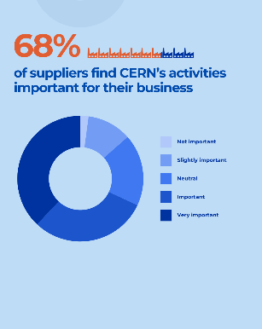
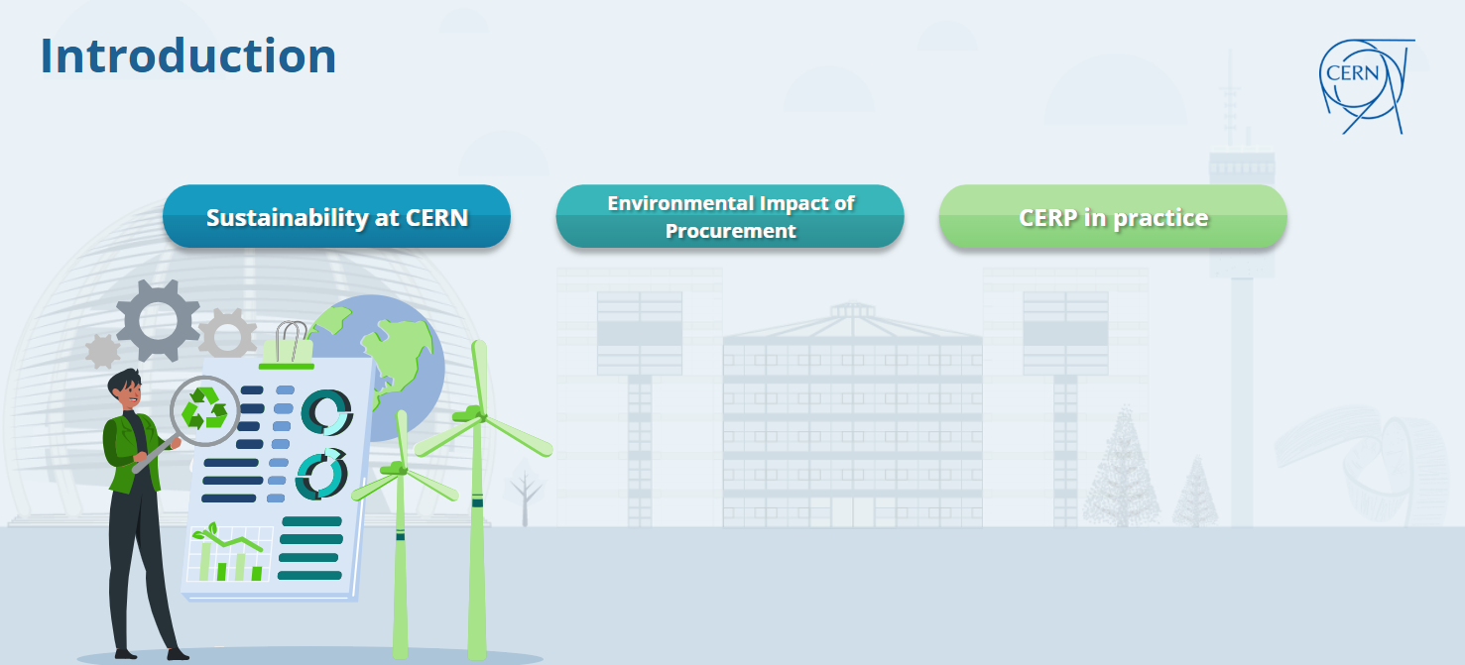
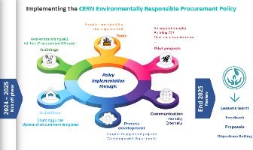
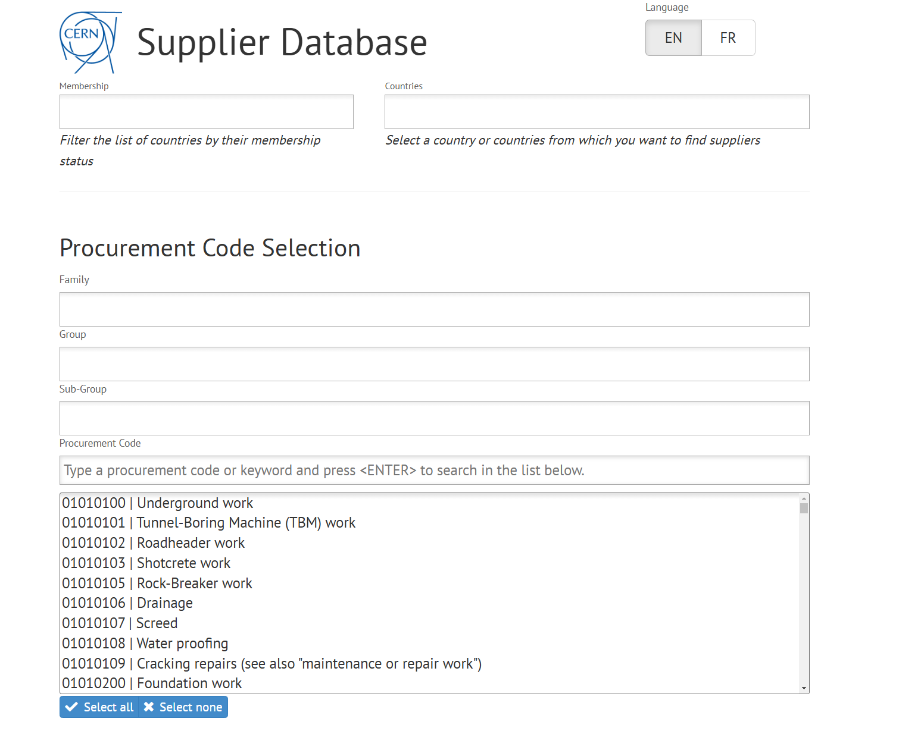
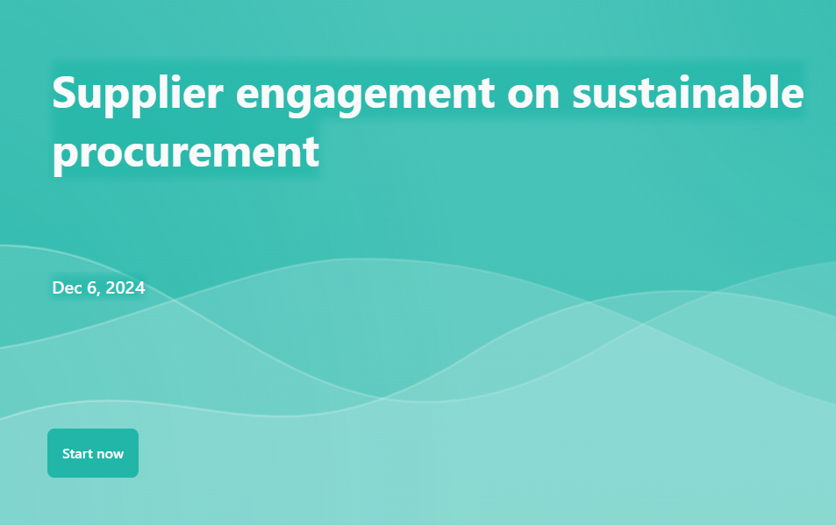
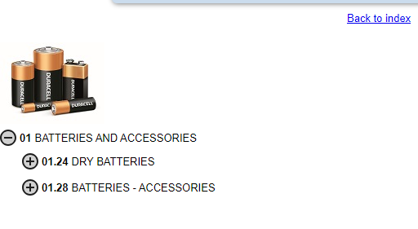
Highlights 2024
CERN FINANCIAL RULES
New Procurement Rules
Supplier Code of Conduct
Impact Survey
CERN Stores Catalogue
Responsible Procurement Workshop (SCE)
Responsible Procurement eLearning
Supplier engagement survey
LinkedIn Channel
Supplier database clean-up
New punch-out catalogues (17 in 2025)

Slide 8
2025 Objectives: strategy, policies and risks control
Procurement Strategy
Mission: being a trusted partner for all stakeholders, as well as describing three strategic objectives, what needs to be done in order to achieve them and how.
Deliver a best-in-class Procurement Service
Promote fair competition and better-balanced industrial return to the Member and Associate Member States
Support the Organization in its sustainability objectives and initiatives
Draft procurement policies on:
Put in place a new Internal Control System
contract management based on different types of contracts (strategic or tactical)
supplier management,
sourcing,
blacklisted suppliers,
use of AI in Procurement
ICS including mitigation measures for each risk identify.
Put in place control measures to confirm that risks are monitored efficiently

Slide 9
2025 Objectives: new procedures
Response Rate Analysis
Review and analysis of the response rates to CERN’s tendering procedures to understand the trends in responses rates, the reasons why firms decide not to participate and implement strategies to increase the overall participation.
4000 responses from firms over the past six years The reasons firms declined were categorised into generic, procedural and technical.
Introduction of improvements on our processes to increase participation and overall competition.
Review the following procedures
Develop a new annual Procurement Report to be presented to FC
Signature routing for contracts and amendments
Signatures necessary for orders
Blacklisting suppliers
More graphic and highlighting more than the industrial return
Put in place the follow up of KPIs defined in the Strategy

Slide 10
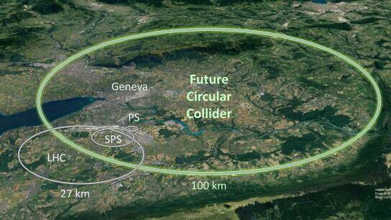
2025 Other objectives: working efficiently
Achieve CERN objective concerning IR
(less than 3 countries <0.4 by 2025)
Develop roles and responsibilities for procurement champions in particular for Norway, Romania and Sweden.
Coordination of future FCC procurements
Put in place a new working platform
Becoming a trusted partner for FCC
Such as Confluence
NEW electricity contracts from 2027
Put in place a new digital platform to collect replies from Market Surveys

Slide 11
2025 Other objectives: communication and outreach
Communication objectives
Continue developing the Procurement LinkedIn Channel
Launch the results of the impact survey carried out in 2024
Organise Industry events (thematic, how to do business with CERN)
Responsible procurement
Organise the first Procurement Days
In collaboration with F4E
Organise new workshops with ATS sector
Supplier engagement
Inviting key procurement professionals and sharing best practices

Slide 12
2024 SATISFACTION SURVEY
Fella Temassine
January 2024

Slide 13
Disclaimer
As of June 2024, there has been a migration from Sharepoint to Microsoft Forms, to conduct the MS/IT satisfaction Survey. Therefore, the data from both systems have been manually matched to obtain consistent data analysis comparable to the previous years.
Additionally, a new survey has been issued on Microsoft Forms for Price Enquiries this year.
Regarding the survey results:
A dissatisfied customer does not necessarily mean the service level is poor;
There are different understandings of «Agree», «Fully agree», and «Neutral»;
Several people are involved in the process (EN-ACE, DO-IT, Stores…), the Procurement Service is evaluated as a whole;
The survey is not necessarily adapted to single source contracts (questions not taken into account where applicable).

Slide 14
Agenda
Scope and data collected
MS/IT survey results
Price Enquiries survey results
Combined overall results

Slide 15
Agenda
Scope and data collected
MS/IT survey results
Price Enquiries survey results
Combined overall results

Slide 16
Scope and data collected
Objective
Evaluate the process, not the persons, and improve it.
Questionnaire
Sent to
Scope
For MS/IT: 24 closed questions + 1 open question;
For Price Enquiries: 20 closed questions + 1 open question;
Questions linked to CERN values and procurement fields;
Scores from 1-Fully disagree to 5-Fully agree, empty answer possible for some questions;
Results are consolidated based on average score.
MS/IT: Tech 1 + Tech 2 + group leader;
Price Enquiries: Tech 1 + Tech 2.
Contracts/Orders >50 KCHF,
All types except amendments, K type, Qx…
Trigger
Date of signature in 2024
Data collected
For MS/IT : 34 answers, 32 contracts, 31 respondents. Responses included 43% of BVFM.
For Price Enquiries : 17 answers, 16 orders, 17 respondents.
For MS/IT:
2023 : 37 answers, 32 contracts, 34 user
2022 : 33 answers, 27 contracts, 29 users
2021: 32 answers, 25 contracts, 27 users
2020: 32 answers, 20 contracts, 26 users
2019: 35 answers, 27 contracts, 30 different users

Slide 17
Agenda
Scope and data collected
MS/IT survey results
Price Enquiries survey results
Combined overall results

Slide 18
Overall satisfaction for MS/IT 2024
Key takeaway:
On the question “The overall level of service provided by the Procurement Service was very satisfactory.”, the average Score is 4,6 in 2024 Vs 4,7 in 2023;
The results are overall extremely positive, with 95% Agree or Fullly agree vs 90% in 2023 and 87% in 2022;
However, it appears that 3% of the respondents “Fully disagree” in 2024 Vs 0% in 2023.
Notes:
Question 18
The overall level of service provided by the Procurement Service was very satisfactory

Slide 19
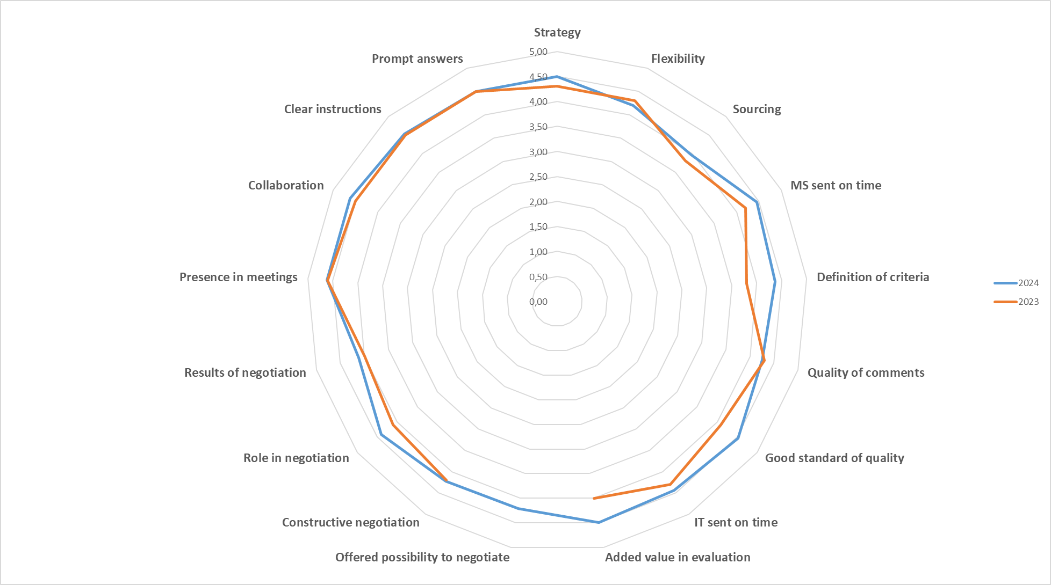
Summary per question
Key takeaway:
All the questions have a good score;
“Offered the possibility to negotiate” is a new question added in the 2024 survey;
“Definition of criteria” is now only asked where BVFM mechanism is applied;
“Flexibility” and “Quality of comments” areas slightly dropped in 2024 Vs 2023;
The lowest scores are respectively on Sourcing (3,9), Results of negotiation (4,1) and Flexibility (4,2).

Slide 20
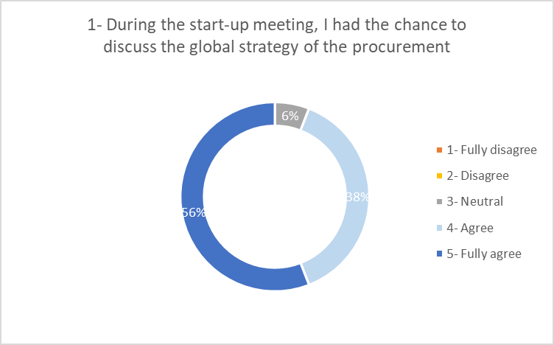
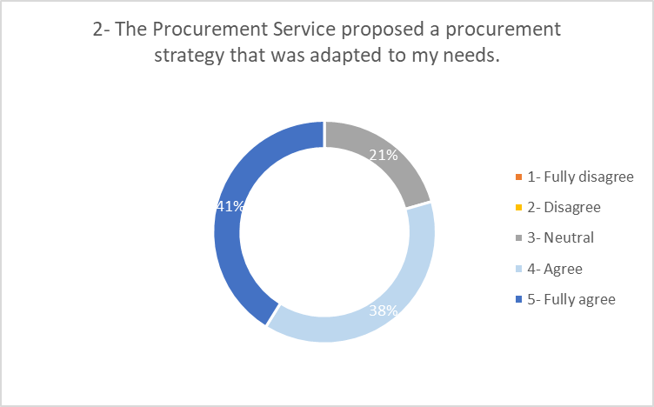
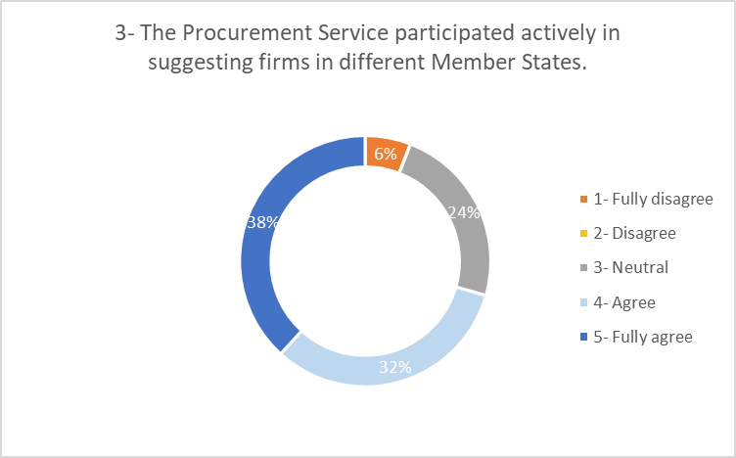
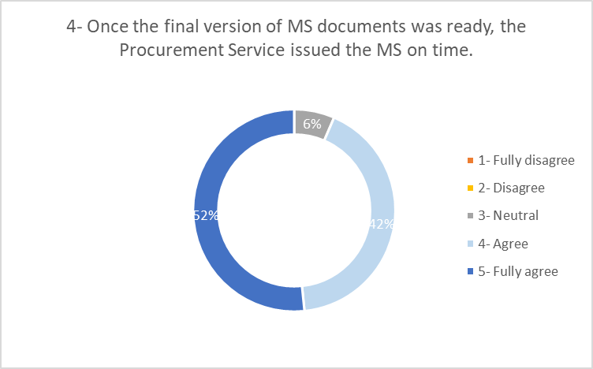
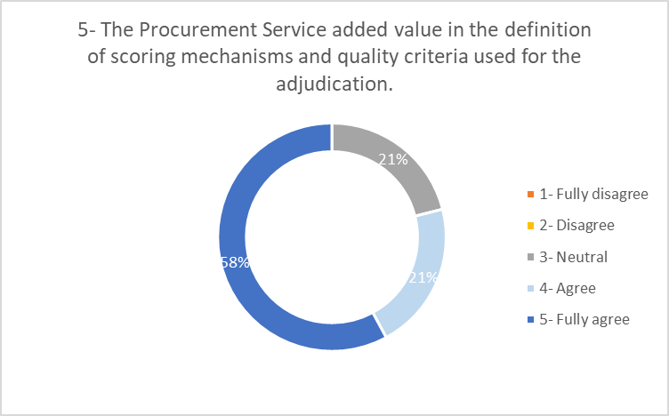
During the Market Survey
Key takeaway:
The main positively perceived areas are “having the possibility to discuss the strategy” and “MS sent on time”;
Key improvement areas could be related to the following metrics:
21% of the respondents remain Neutral when asked if the “procurement strategy was adapted to their needs” or if “the procurement service added value in the definition of adjudication criteria”;
“Actively suggesting firms” is positively perceived by 70% of the respondents.

Slide 21
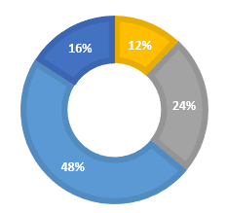
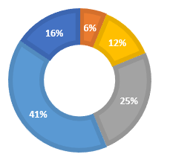
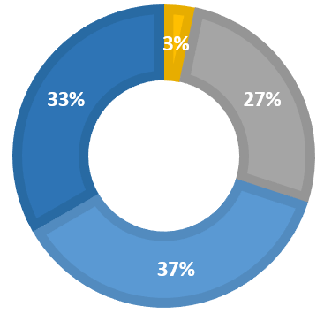
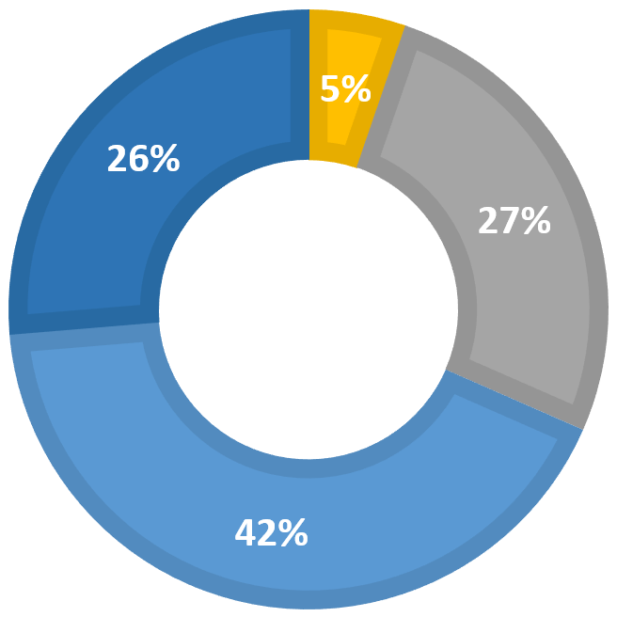
Focus on Sourcing
2020
2021
2022
2023

Slide 22
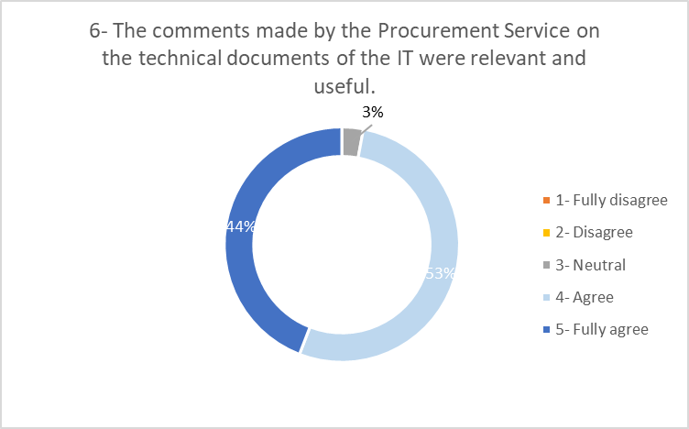
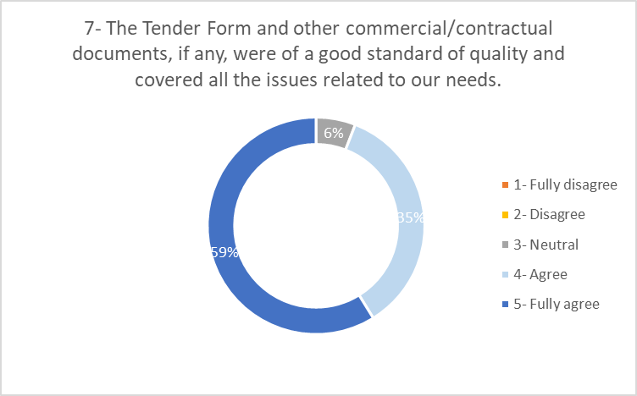
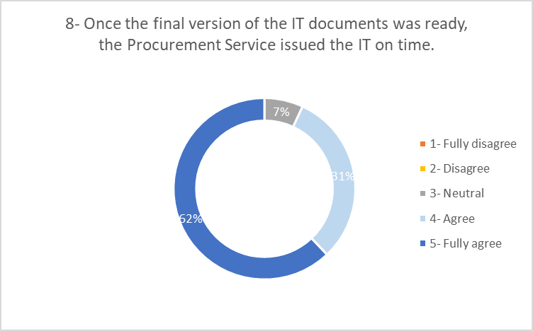
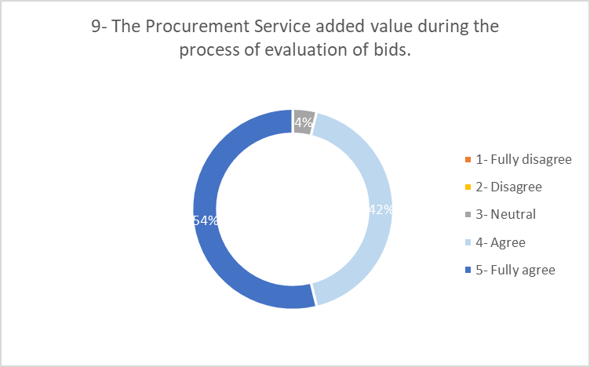
During the Invitation to Tender
Key takeaway:
Overall, the questions related to the Invitation to Tender have extremely positive responses.

Slide 23
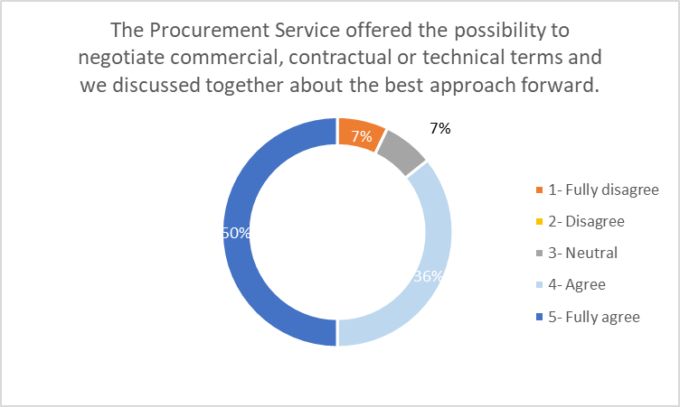
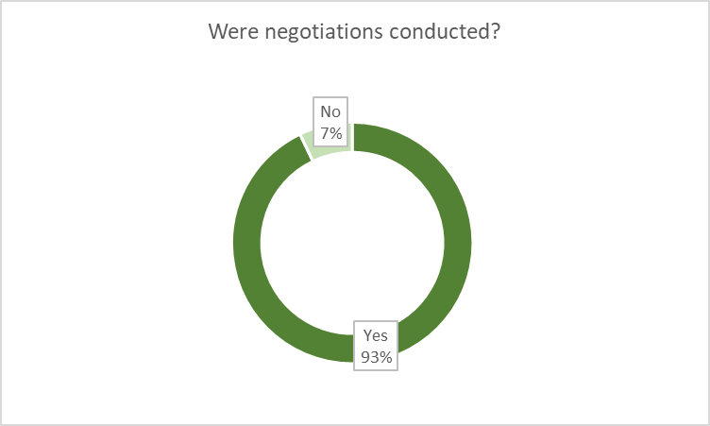
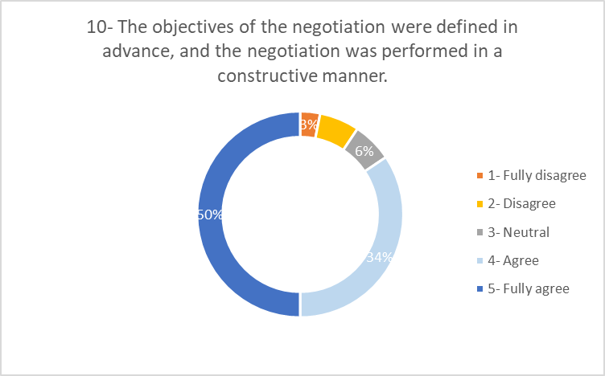
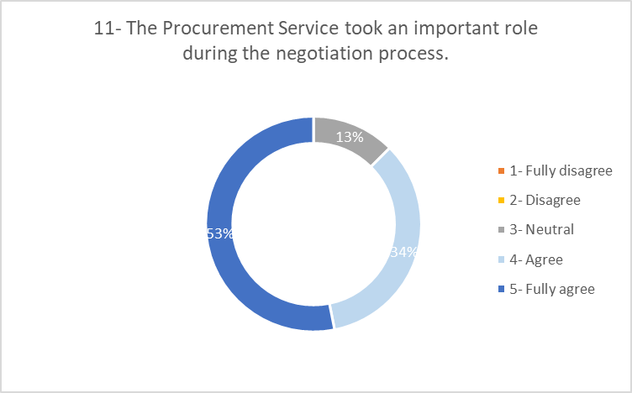
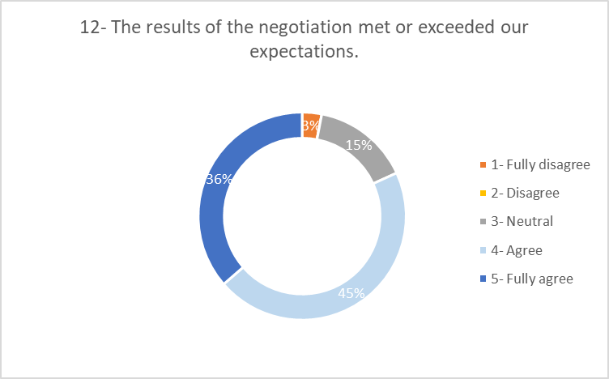
During the negotiation
New
New
Key takeaway:
86% of the respondents either “Fully agree” or “Agree” with the fact that they were given “the possibility to negotiate”;
Largely positive responses were received on “negotiation objective definition”, “procurement important role during negotiation” “results of the negotiation”, while between 13-15% “Neutral” responses received for these 3 questions.

Slide 24
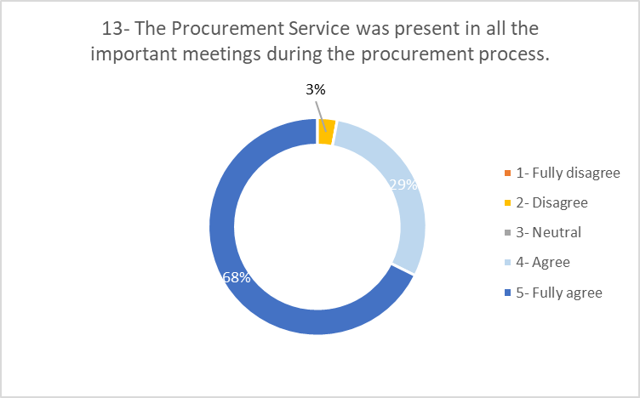
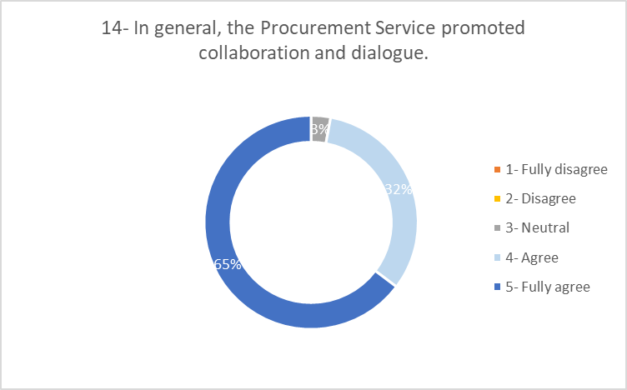
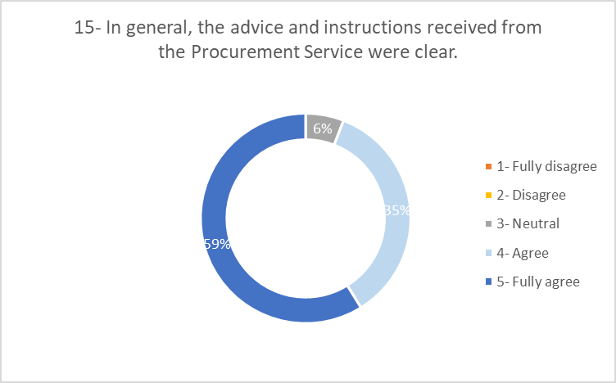
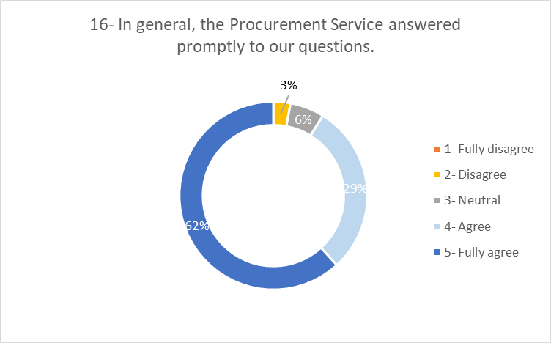
Overall added value
Key takeaway:
“Promoting collaboration” and giving “clear instructions” appear as areas of strengths;
Procurement service “presence in important meetings” and “providing prompt answers” are also positively perceived, only 3% of the respondents appear to Disagree.

Slide 25
Feedback and suggestions
The positive aspects:
The improvement areas:
“Thanks again to X and the IPT team for their support!”
“The service provided was of good quality; however, the procedure this time was notably more burdensome compared to previous experiences. The volume of comments made has significantly increased, likely tripling compared to prior contracts. This escalation in administrative complexity is concerning, especially given the relatively small scale of the contract. Despite the added layers of bureaucracy, it remains unclear if there is any tangible benefit derived from this increased complexity. Furthermore, only two out of the three contracts have been signed, which may indicate potential delays or inefficiencies in the process. In summary, while the service quality remains commendable, the administrative side of the procedure is becoming increasingly cumbersome, raising questions about the necessity and value of such extensive processes for contracts of this size. ”
“Interaction with X was exemplary”
“This was (and still is) a very complicated procurement and the support provided by the Procurement Service has been essential.”
“Le professionnalisme et l'efficacité du service ont grandement contribué à la réussite des projets SCE-PPM. Un axe d'amélioration consisterait à pouvoir attribuer à plusieurs entreprises un même appel d'offres, comme cela se fait dans le cadre de la loi MOP française ou de la LMP suisse (Allotissement).”
“Good support as usual from X and her back-up!”
“There was poor support on the analysis of the MS results which involved the technical party over too much days of work. ”
“I would have appreciated to have more exchange meeting in site to complete the documents and to avoid to do 3 times the technical specifications”
“ I am happy with the support provided by IPT. In the future, it should be possible to conclude this type of contract without the need to demand a bank guarantee from the contractor. ”

Slide 26
Agenda
Scope and data collected
MS/IT survey results
Price Enquiries survey results
Combined overall results

Slide 27
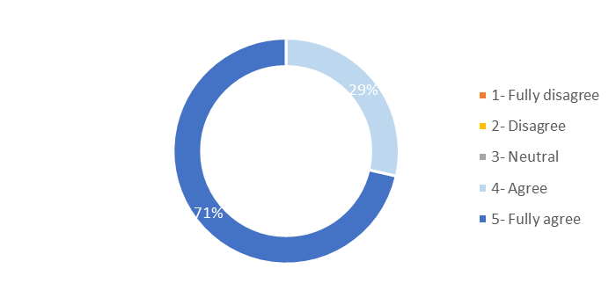
Overall satisfaction for Price Enquiries 2024
Key takeaway:
Average Score: 4,7/5 with 17 answers received since June 2024;
Although this is the first year that a survey dedicated to the Price Enquiries is conducted, the results are overall very positive;
For this specific question positive responses have been recorded.
Notes:
Question 18
The overall level of service provided by the Procurement Service was very satisfactory

Slide 28
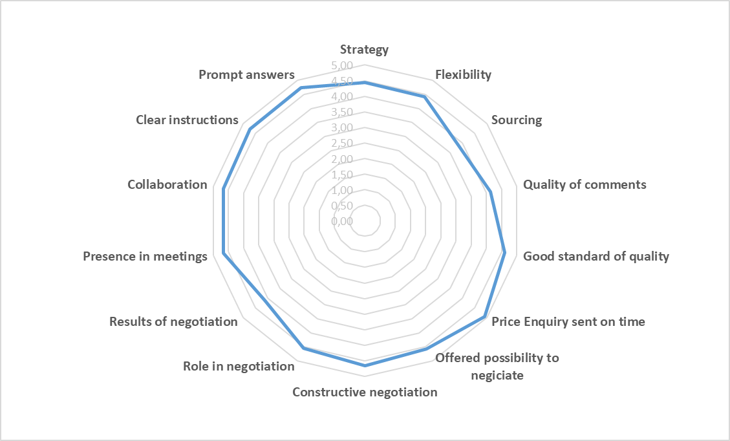
Summary per question
Key takeaway:
All the questions have an average score above 4,4/5, except for Sourcing (3,9), Results of negotiation (4,1) and Quality of comments (4,1);
Sending the Price Enquiry on time question has the excellent score of 4,9/5.

Slide 29
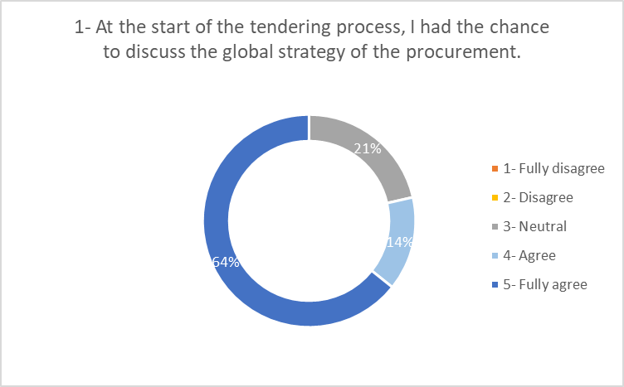
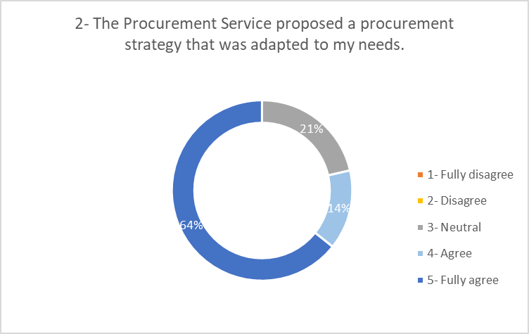
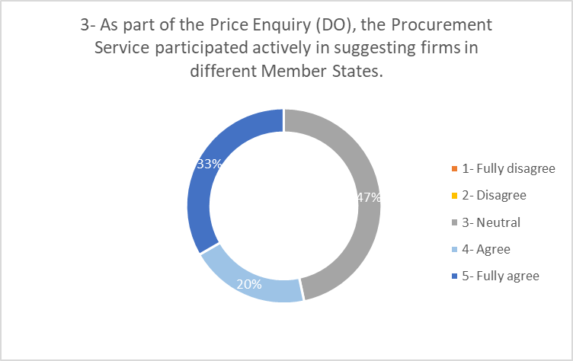
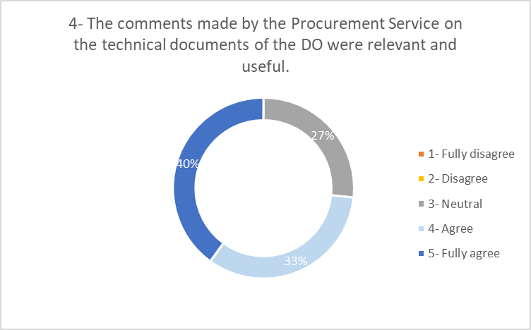
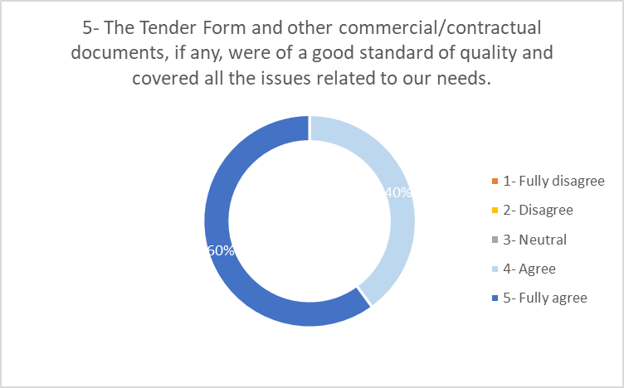
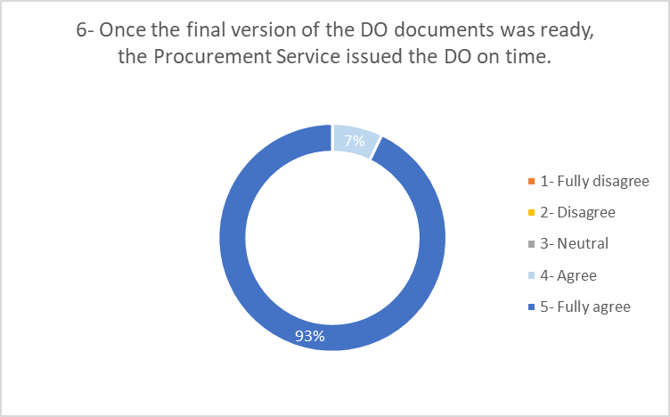
During the tendering process
Key takeaway:
21% of the respondents are neutral when asked if they “had the chance to discuss the global strategy” or if the “proposed strategy was adapted to their needs”;
“Actively suggesting firm” (Sourcing) is only positively perceived by 53% of the respondents;
A third of the respondents remains neutral regarding the “relevance of comments made by the Procurement Service”;
The “quality of the documents” as well as the “timeliness of the DO dispatch” are extremely positively perceived by the respondents.

Slide 30
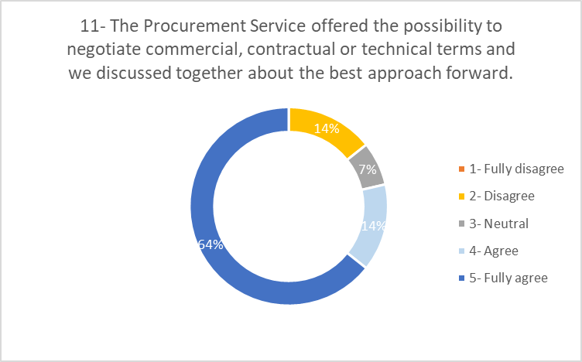
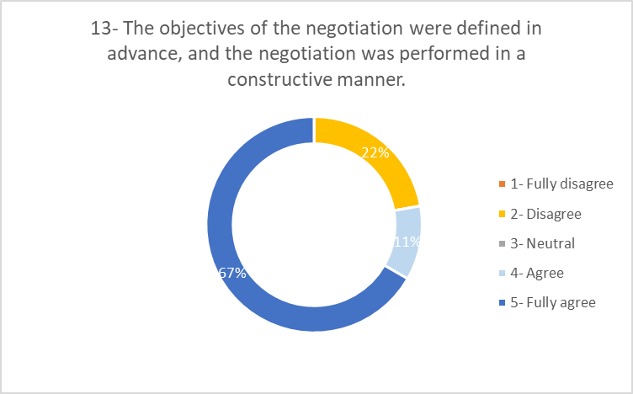
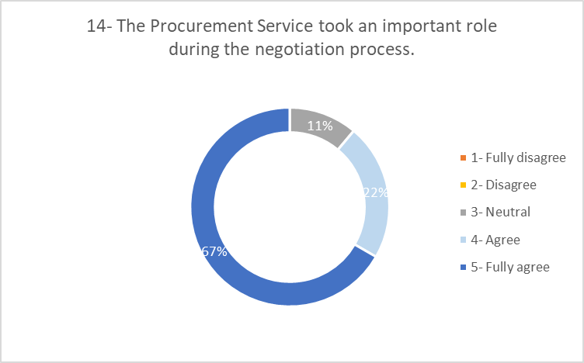
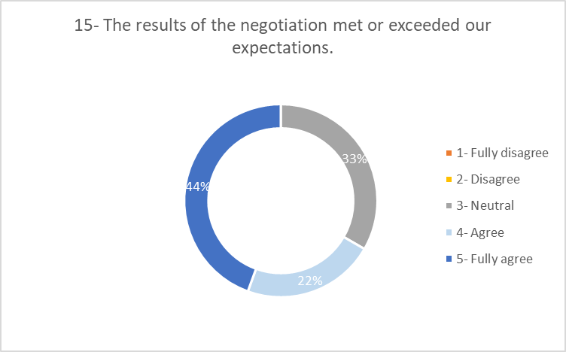
During the negotiation
Key takeaway:
A vast majority (78%) of the respondents consider that “the Procurement Service offered the possibility to negotiate” and “ran the negotiation in a constructive manner”. Nevertheless, 14% and 22% of the respondents respectively disagree on these statement;
“The results of the negotiation” have triggered 33% Neutral responses.

Slide 31
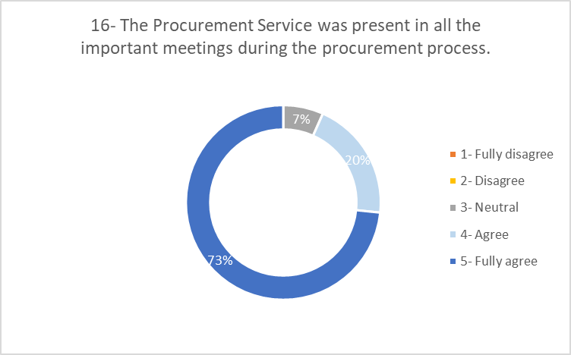
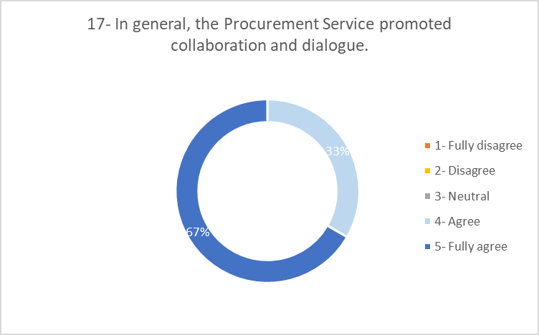
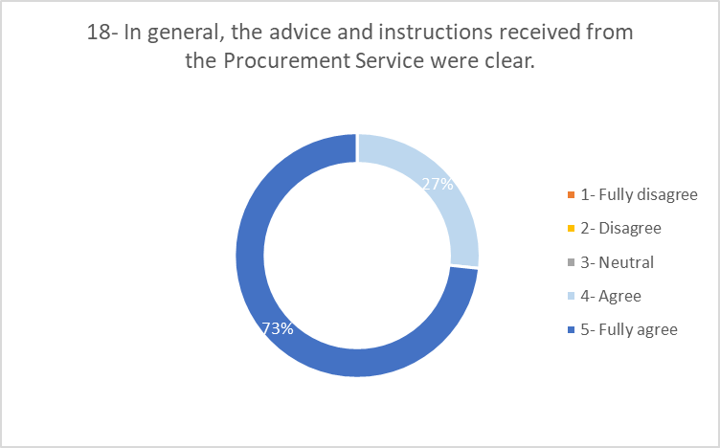
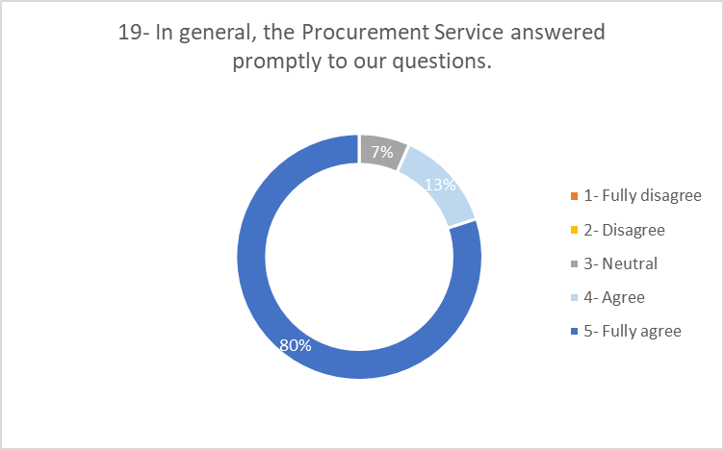
Overall added value
Key takeaway:
“Promoting collaboration” and giving “clear instructions” appear as areas of strengths is the same way as in the MS/IT survey;
“Procurement service presence” and “providing prompt answers” are also positively perceived. Only 7% of respondent reported as Neutral.

Slide 32
Feedback and suggestions
The positive aspects:
The improvement areas:
“Nice to work with you, as usual”
N/A
“X handled (also) this procurement with good level of professionalism and achieved cost efficiency in the overall procurement”
“Is always a pleasure to work with X. She is extremely professional and proactive.”
Key takeaway:
Three positive written feedbacks received, representing 18% of the responses;
No negative feedback nor area of improvement received for Price Enquiries.

Slide 33
Agenda
Scope and data collected
MS/IT survey results
Price Enquiries survey results
Combined overall results

Slide 34
Combined overall satisfaction 2024
4,6/5
Key takeaway:
The combined rate above is considering the average weighted MS/IT score of 4,6 for 34 responses and the average Price Enquiry score of 4,7 for 17 responses.
Notes:
Question 18
The overall level of service provided by the Procurement Service was very satisfactory

Slide 35
Key takeaways
Summary:
An extremely positive combined overall satisfaction score: 4.6/5 in 2024
Key feedbacks:
Good support from procurement
Professionalism and efficiency
More support requested on MS analysis
Requested a less cumbersome administrative procurement procedure
Need for bank guarantee challenged

Slide 36
How can we improve?
Sourcing
Categorisation (category managers) is now supposed to bring value and expertise in terms of sourcing – this is our responsibility!
A country champion role is being created to help with countries eligible to LT (see next presentation) – this will require smooth coordination / early warning
A working group has been appointed to drive the Sourcing in a more efficient way and to write the dedicated policy. The working group will also investigate AI-related solutions with the objective of improving the score on this topic by next year’s survey.
By default, we have to actively suggest firms by leveraging:
Internet;
filtered supplier DB ;
Le Chat or chat GPT;
Getting the right contacts;
Checking previous ‘similar’ tenders;
Sharing the opportunity on LinkedIn channel.
Notes:
Question 18
The overall level of service provided by the Procurement Service was very satisfactory

Slide 37
How can we improve?
Negotiation
Overall, the results for MS/IT are consistent over the past five years. The results are slightly different for Price Enquiries. Price Enquiries are not necessarily ‘less important’ – open the discussion on whether negotiations should be made or not!
Why it is important? Savings are used to promote the Procurement Service added value.
How?
Having a comprehensive approach (savings, yes, but not only);
Raising the point systematically at the opening;
Deciding the strategy in collaboration with the Technical Officer;
Deep diving in the details;
Post-negotiation, it is very important to update the savings achieved above 2 KCHF here. A new tool will be developed in 2025 – this will also include cost avoidance;
Negotiation trainings are available.
Notes:
Question 18
The overall level of service provided by the Procurement Service was very satisfactory

Slide 38
How can we improve?
MS results analysis
A project has been prioritised in the Procurement Excellence roadmap to automate the way responses are consolidated and analysed, which will be answering the feedback received on the same topic.
Added Value
As business partners, Procurement officers have a very important role in the tendering process. The procurement strategy was just approved, the related policies and forthcoming changes to our procedures are being put in place with the objective of providing best-in-class service to internal customers.
Bank guarantees
Bank guarantees requirements have been recently updated and presented during a dedicated Quality session.
Notes:
Question 18
The overall level of service provided by the Procurement Service was very satisfactory

Slide 39
PROCESS EXCELLENCE ROADMAP
Charles Carayon
January 2024

Slide 40
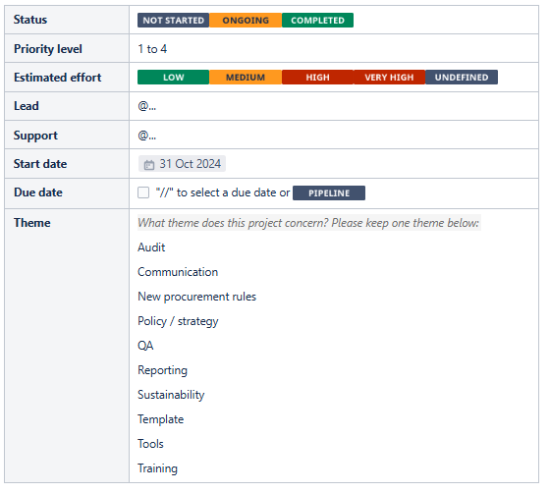
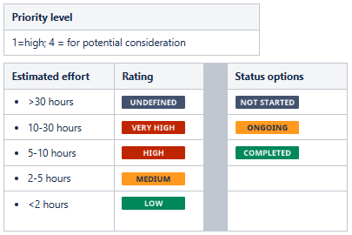
Process Excellence: intro
Objective: help PI meet its strategic objectives
70+ (sub)projects identified, ranked by priority level and aprox. effort
This ppt only shows priority 1 projects
Follow-up in Confluence

Slide 41
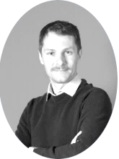
Core team

Slide 42
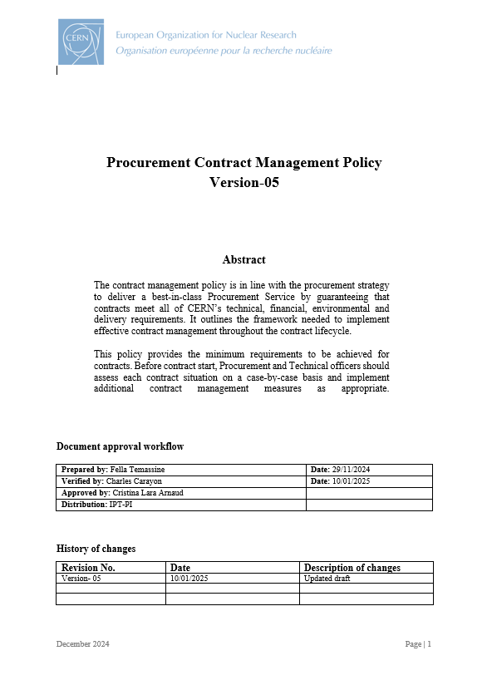
2025 roadmap: strategy / policies
Approval of the procurement strategy and related policies

Slide 43
2025 roadmap: tools
Set up a Confluence platform to:
Have comprehensive information platform with easy-search function (soon replacing PI website (group members))
Document / follow-up projects (PE projects, CERP, …)
Serve as logbook (critical contracts / suppliers / sourcing…)

Slide 44
2025 roadmap: tools
New Source-To-Pay (S2P) tool:
Define needs and possible solutions;
Launch a Market Survey (ideally).
New MS platform (QQ + automated evaluation)
New tool to register savings / cost avoidance
New internal control system (ICS)

Slide 45
2025 roadmap: tools
Implemement PI strategy’s KPIs:
At least 6 trainings provided for all team members.
All junior members are offered a partially funded training programme
Periodic engagement survey with at least 80% of team engaged/aligned
Customer satisfaction: at least 80% of satisfied clients
Savings + cost avoidance > 2* PI’s operating cost
85% of orders approved within 5 working days
At least 20 LT per year
100% of strategic contracts with risk assessment and risk mgmt. plan
Reduction by 20% of ‘no reply’ by 2028
50 suppliers assessed in terms of sustainability performance
25 top-emitting suppliers reporting on CO2 emissions per year
2 workshops per year and training material developed
3K followers
Periodic procurement conference
2 industry webinars
per year
…

Slide 46
2025 roadmap: other topics

Slide 47
2025 roadmap: sustainability
A dedicated project/knowledge base
Supplier engagement strategy per family
Meet KPIs
PO training
Pilot projects
Workshop with ATS/IT
End-of-year project review
…

Slide 48
Next
KO and thematic coordination meetings
Feel free to already use Confluence (still work in progress) and to provide feedback

Slide 49
BCO - update
Simon Guerri dall’Oro (IPT-PI-OS)
January 2024

Slide 50
DAI – MODIFIED / AMENDMENT
Modified button has been improved with the possibility to show fields such as “Delivery Instructions”, “Payment Conditions” and “Procurement officer Information”,
It is now easier to modify your order directly in EDH (without Qualiac)
Thanks to Alvaro for suggesting and managing the change with FAP-BC

Slide 51
DAI – Intervention on the CERN Site
For onsite interventions (in France AND/OR Switzerland),
Technical Officer can now select, in the DAI, the place of intervention.
The boxes ticked will define the labour law applicable to the contractor’s personnel

Slide 52
DAI – Intervention on the CERN Site
For intervention on BOTH sides (FR + CH), the 4P applies.
4P = Part Prépondérante Prévisible de la Prestation
4P determines a unique applicable labour law while the Contractor performs services at CERN, regardless the country where services are performed.

Slide 53
DAI – Intervention on the CERN Site
In case of 4P :
In the DAI, the Technical Officer determines the country where most of the services will be performed, this will define the applicable labour law.
The Procurement Officer controls the information in the DAI
The Procurement Officer writes the 4P memo

Slide 54
How to establish the 4P:
Ask statistics to the TO, the statistics should be an estimated volume (in time spent or nb of installations) of the future services.

Slide 55
How to establish the 4P:
Prepare the memo: Document templates - Procurement Group (IPT-PI) - CERN Confluence
Have it reviewed by Seb or Charles
Launch Docusign:
DO/IT: TO + GL + DH + PO + IPT-PI-SE SL
DAI: TO + his/her SL + PO + IPT-PI-SE SL
Save the memo in DAI + Shared + complete the xls (\\cern.ch\dfs\Departments\FP\Groups\PI\Shared\IPT-PI-SE\3.3-Services\1-Onsite_services\4P)

Slide 56
If you have to remember one thing…*
*…or two

Slide 57
1 - Whenever there are onsite activities, ask yourself if the 4P regime applies
2 – If needed, ask IPT-PI-SE for advice
3- Dedicated ¼ d’heure qualité soon

Slide 58
AOB

Slide 59
Limited Tendering & Country Champions

Slide 60
Limited tendering
Only 3 procedures awarded in 2024 … LT must be used extensively in 2025
Beware:
country of origin must be >60% from countries eligible to LT
SL to be invited at opening, even for DOs
Guidelines: https://procurement.web.cern.ch/faq-category/limited-tendering-faqs
When should a LT procedure take place?
For DOs: If at least 4 firms eligible are identified
For ITs: If at least 6 firms eligible are identified
to ensure enough competition

Slide 61
At least 20 LT per year !
Limited tendering
Limit competition to (2025 tentative list):
Country champions
Mandate (tbc)
Timeframe for impact in 2025
Brasil
Ukraine
Israel
Cyprus
Romania
Sweden
Norway
Greece
Pakistan
Belgium
UK
Serbia
Alvaro
-
tbc
Eva
Mihaela
Josephine
Merethe
Eva
-
Nordine
Adam
-
Sourcing
IR monitoring
Contact for industry
=> Get them involved !
January to
June !

Slide 62
Reminder

Slide 63
Sustainable Procurement: raising awareness training: Link
=> Please follow the course
=> Next: dedicated training for POs

Slide 64
Updated Minute Rose

Slide 65
New field to specify whether the contract / amendment should be reported as supplies / MOCS / Utilities

